Slide 1
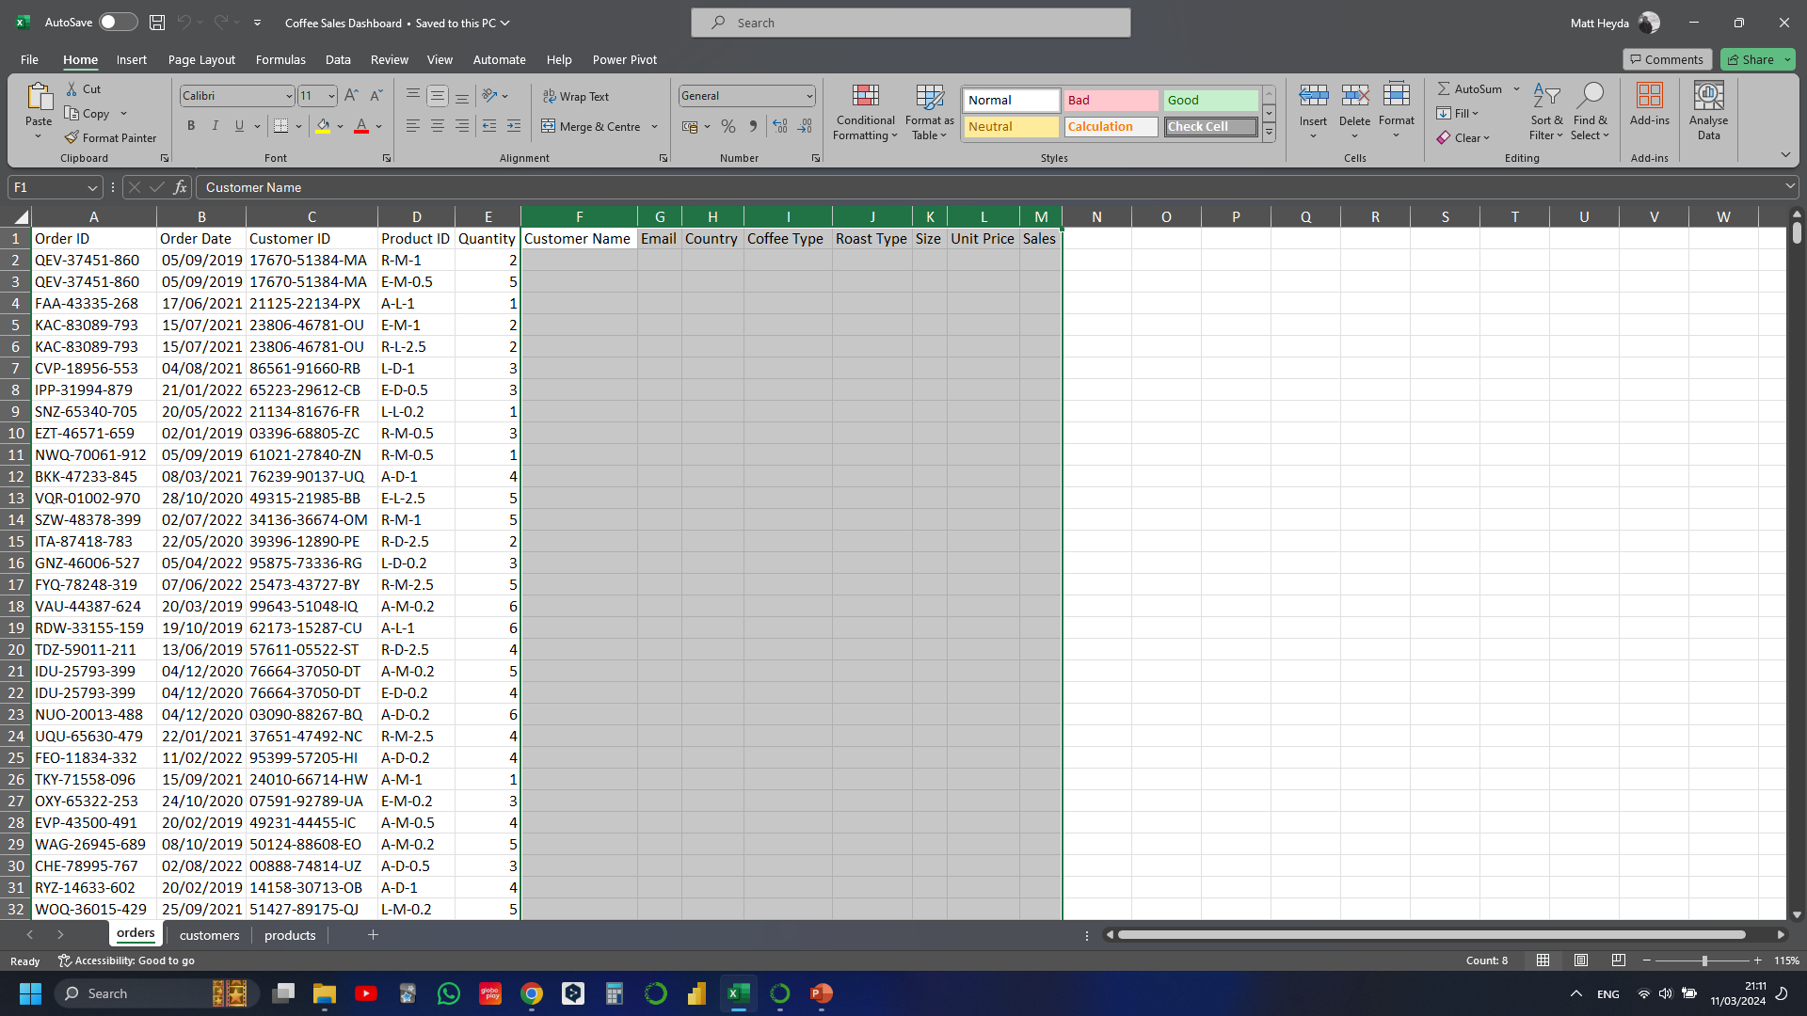
Notes:
Gathering the customer data using XLOOKUP
I use INDEX MATCH to gather the product data

Slide 2
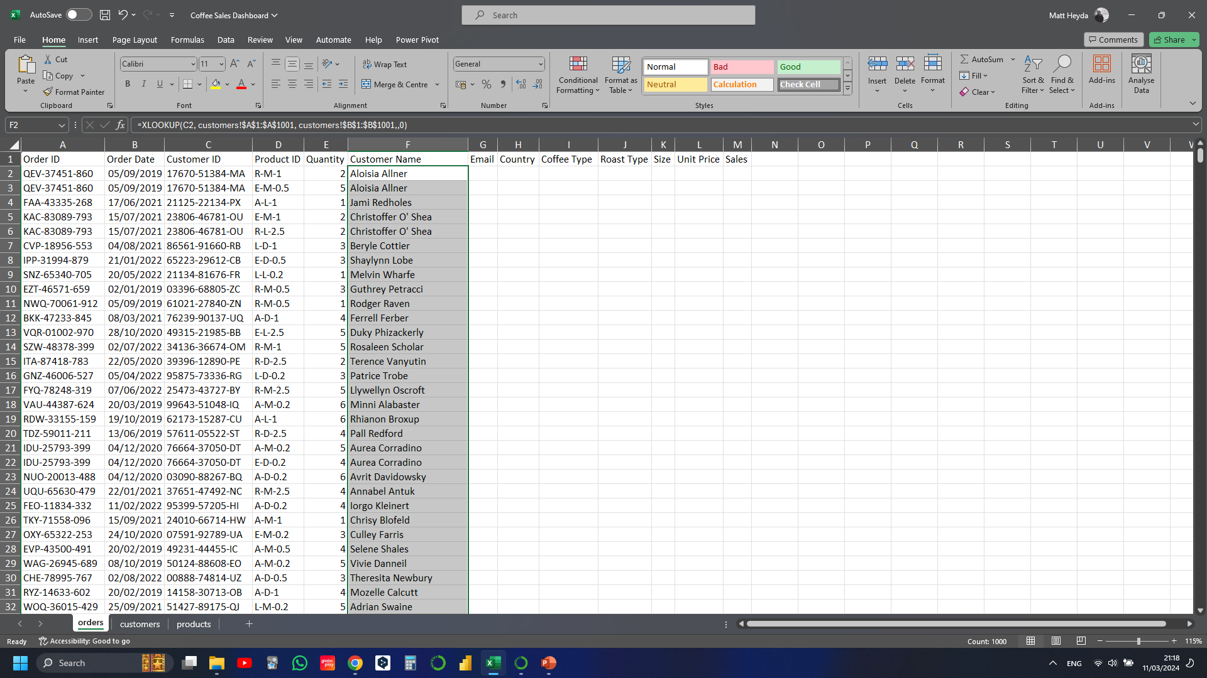
Notes:
Gathering the customer data using XLOOKUP
Customer Name
e.g. =XLOOKUP(C2, customers!$A$1:$A$1001, customers!$B$1:$B$1001,,0)

Slide 3
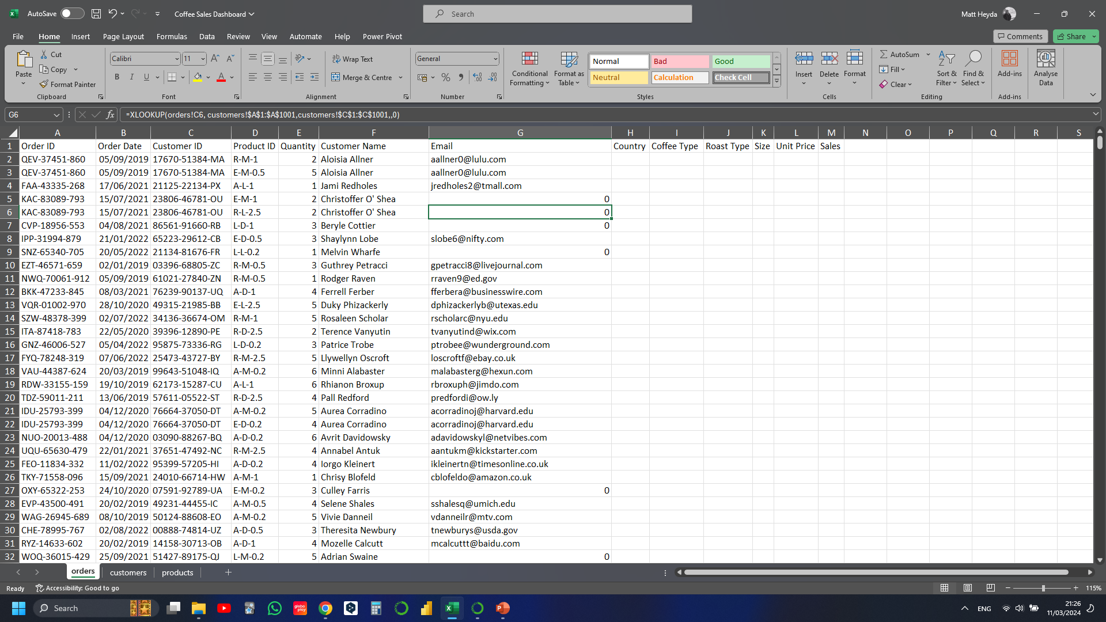
Notes:
Want to remove the 0s from the column rows.

Slide 4
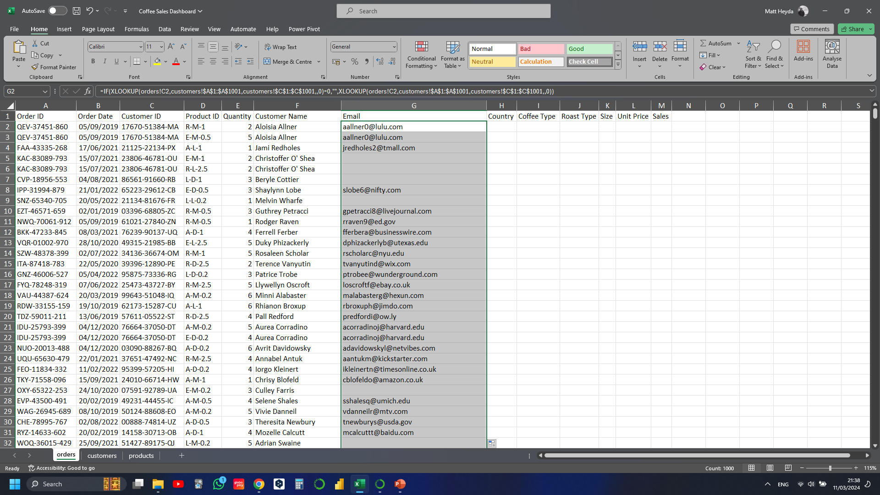
Notes:
0s removed from all rows
=IF(XLOOKUP(orders!C2,customers!$A$1:$A$1001,customers!$C$1:$C$1001,,0)=0,"",XLOOKUP(orders!C2,customers!$A$1:$A$1001,customers!$C$1:$C$1001,,0))

Slide 5
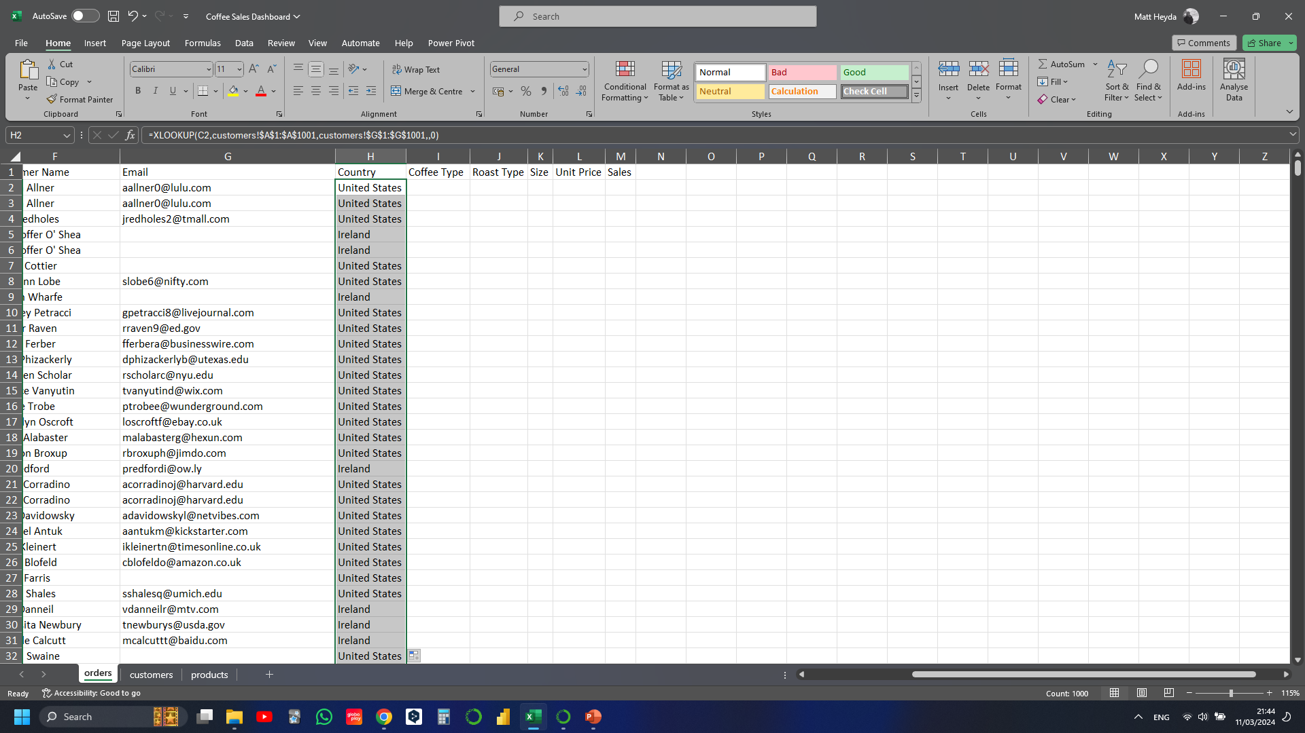
Notes:
=XLOOKUP(C2,customers!$A$1:$A$1001,customers!$G$1:$G$1001,,0)

Slide 6
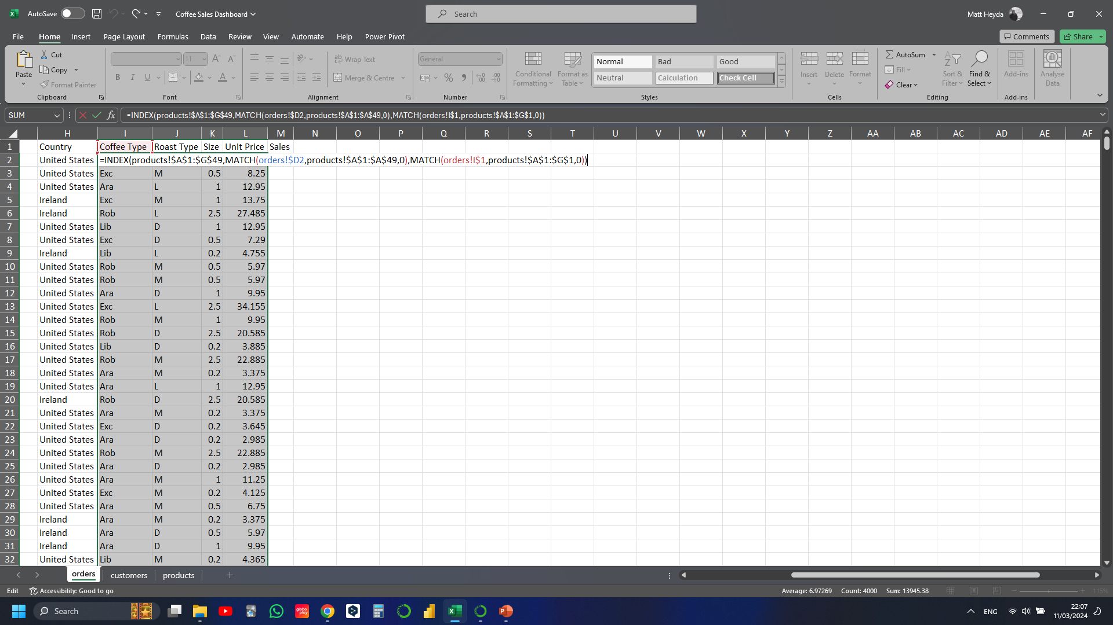
Notes:
Moving onto product information
Could use XLOOKUP here but using INDEX MAX as its dynamic
=INDEX(products!$A$1:$G$49,MATCH(orders!$D2,products!$A$1:$A$49,0),MATCH(orders!I$1,products!$A$1:$G$1,0))
$D ($ before the letter) means that we’re locking in the column
I$1 ($ before the number) means that we’re locking in the row

Slide 7
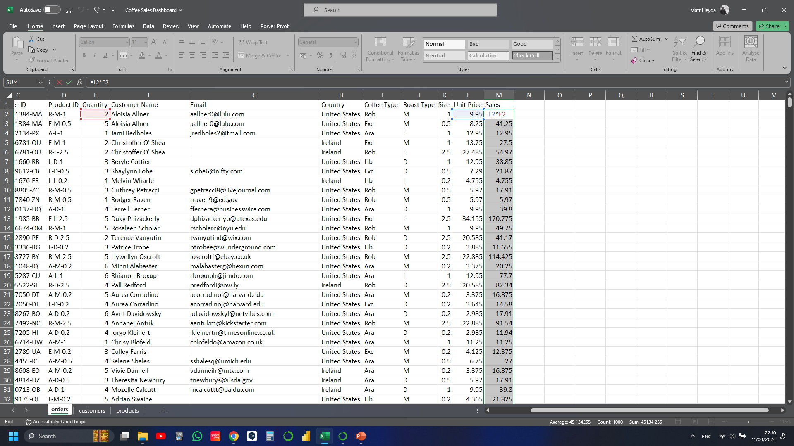
Notes:
Populating the Sales column
Simple formula (Unit Price * Quantity)

Slide 8
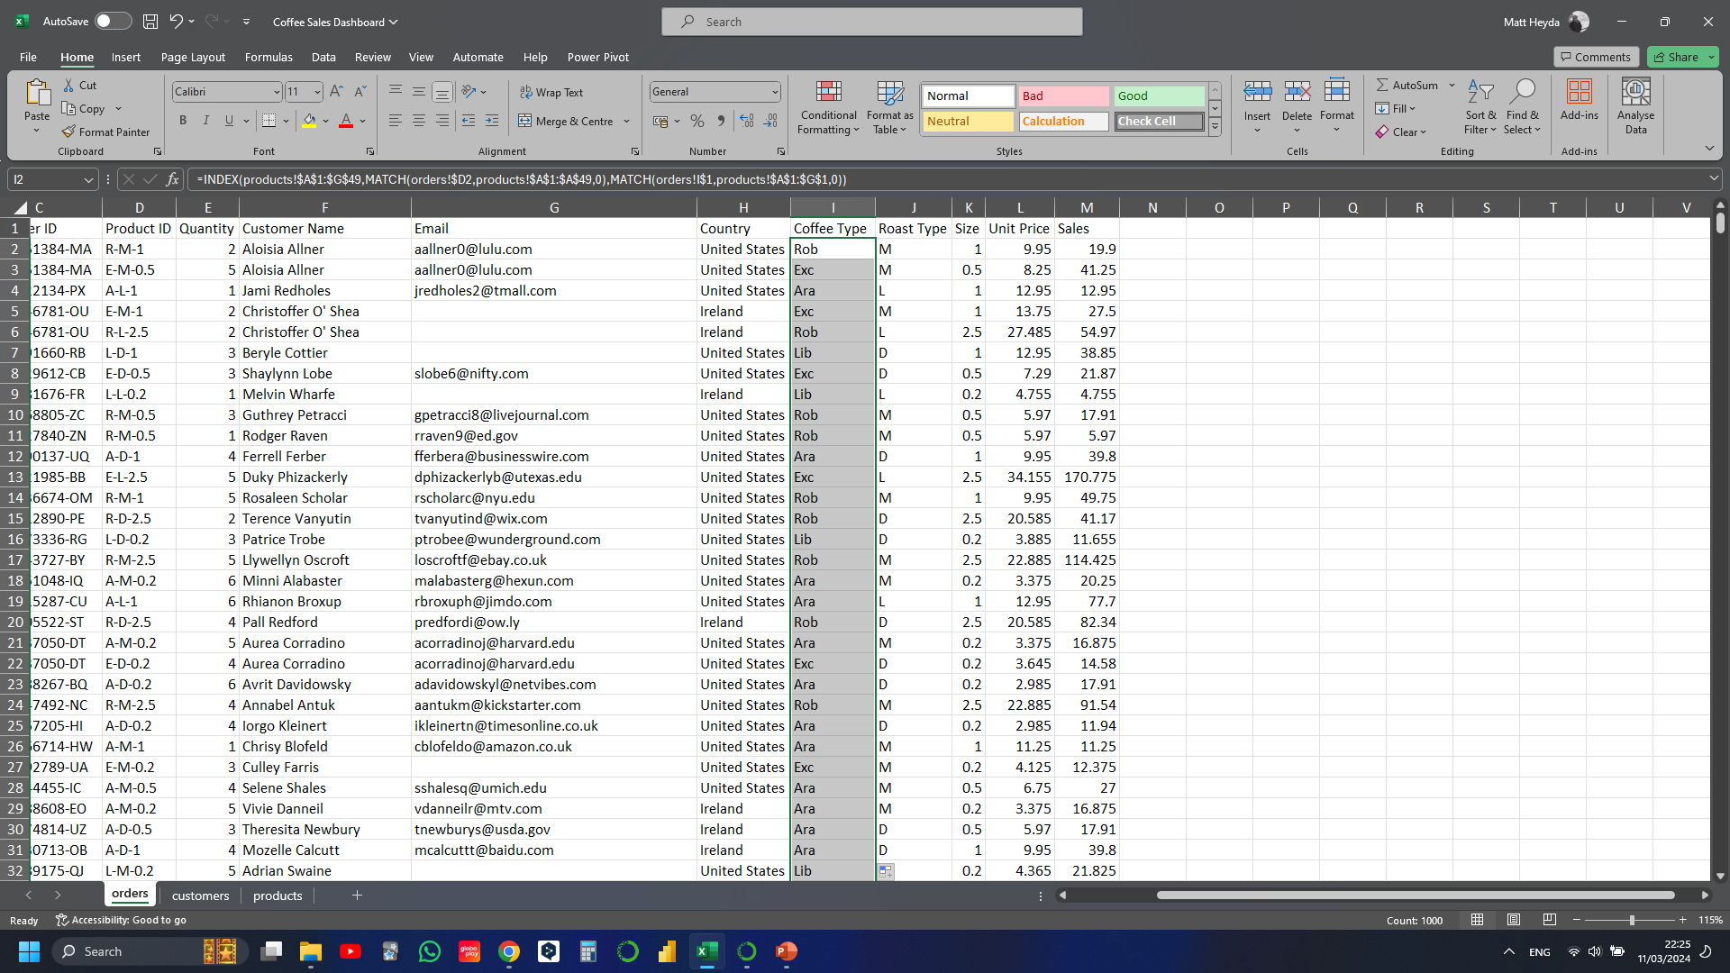
Notes:
Want to change the abbreviations to full coffee type name

Slide 9
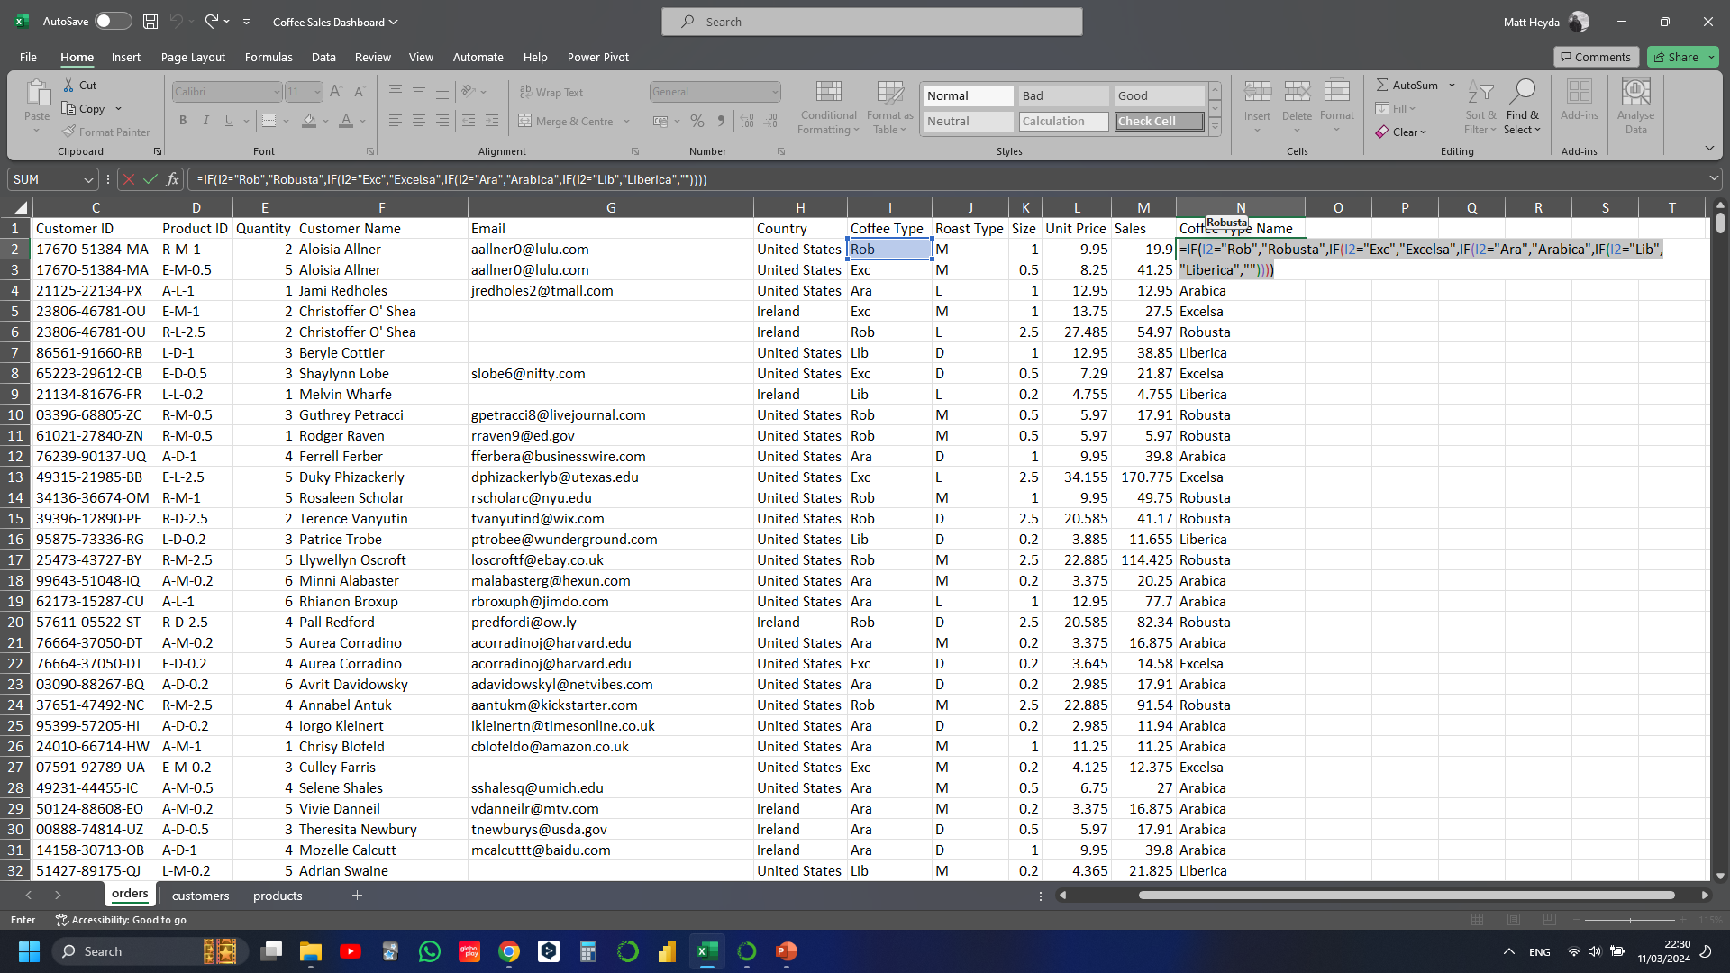
Notes:
=IF(I2="Rob","Robusta",IF(I2="Exc","Excelsa",IF(I2="Ara","Arabica",IF(I2="Lib","Liberica",""))))

Slide 10
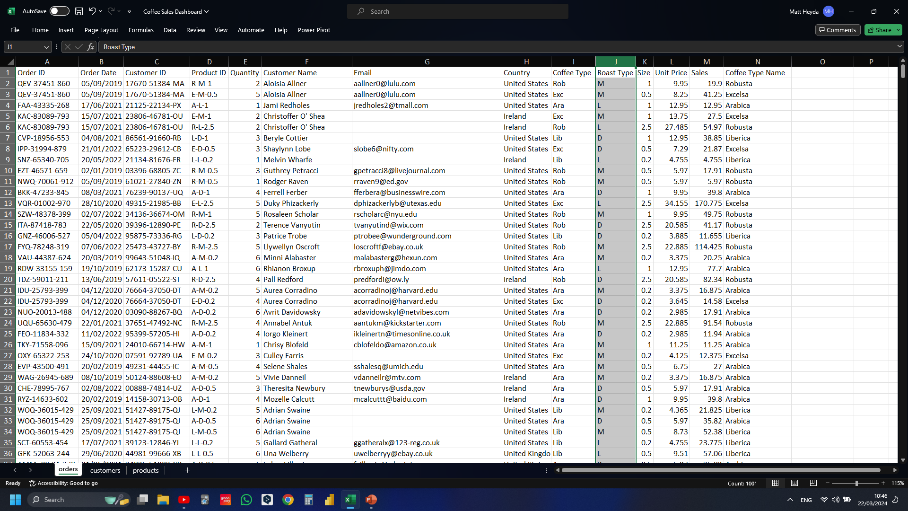
Notes:
Want to change the roast type abbreviations to full names

Slide 11
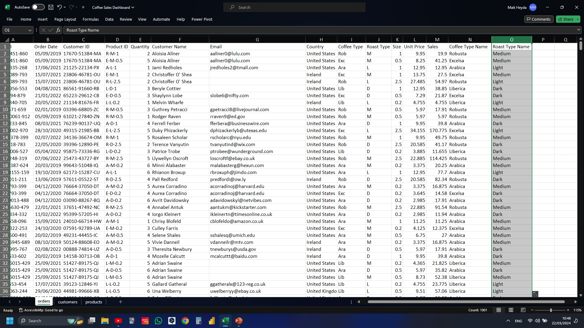
Notes:
=IF(J2="M","Medium",IF(J2="L","Light",IF(J2="D","Dark")))

Slide 12
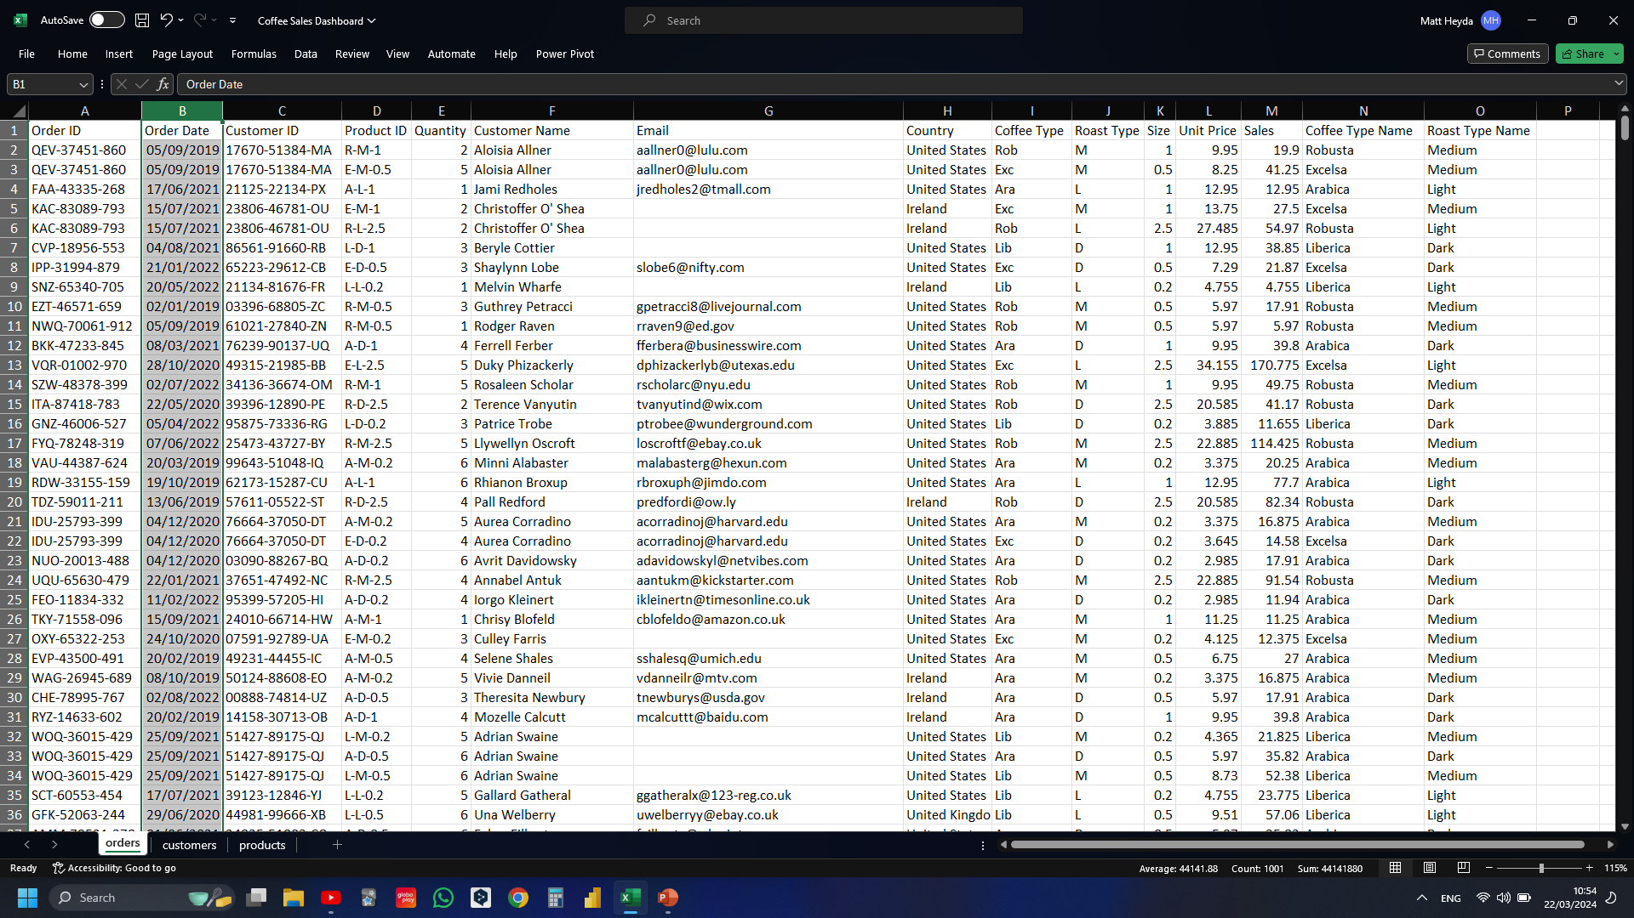
Notes:
Want to format the dates so that the month shows up as a 3 letter abbreviation, because date formats are different between different regions and this makes it much cleaer

Slide 13
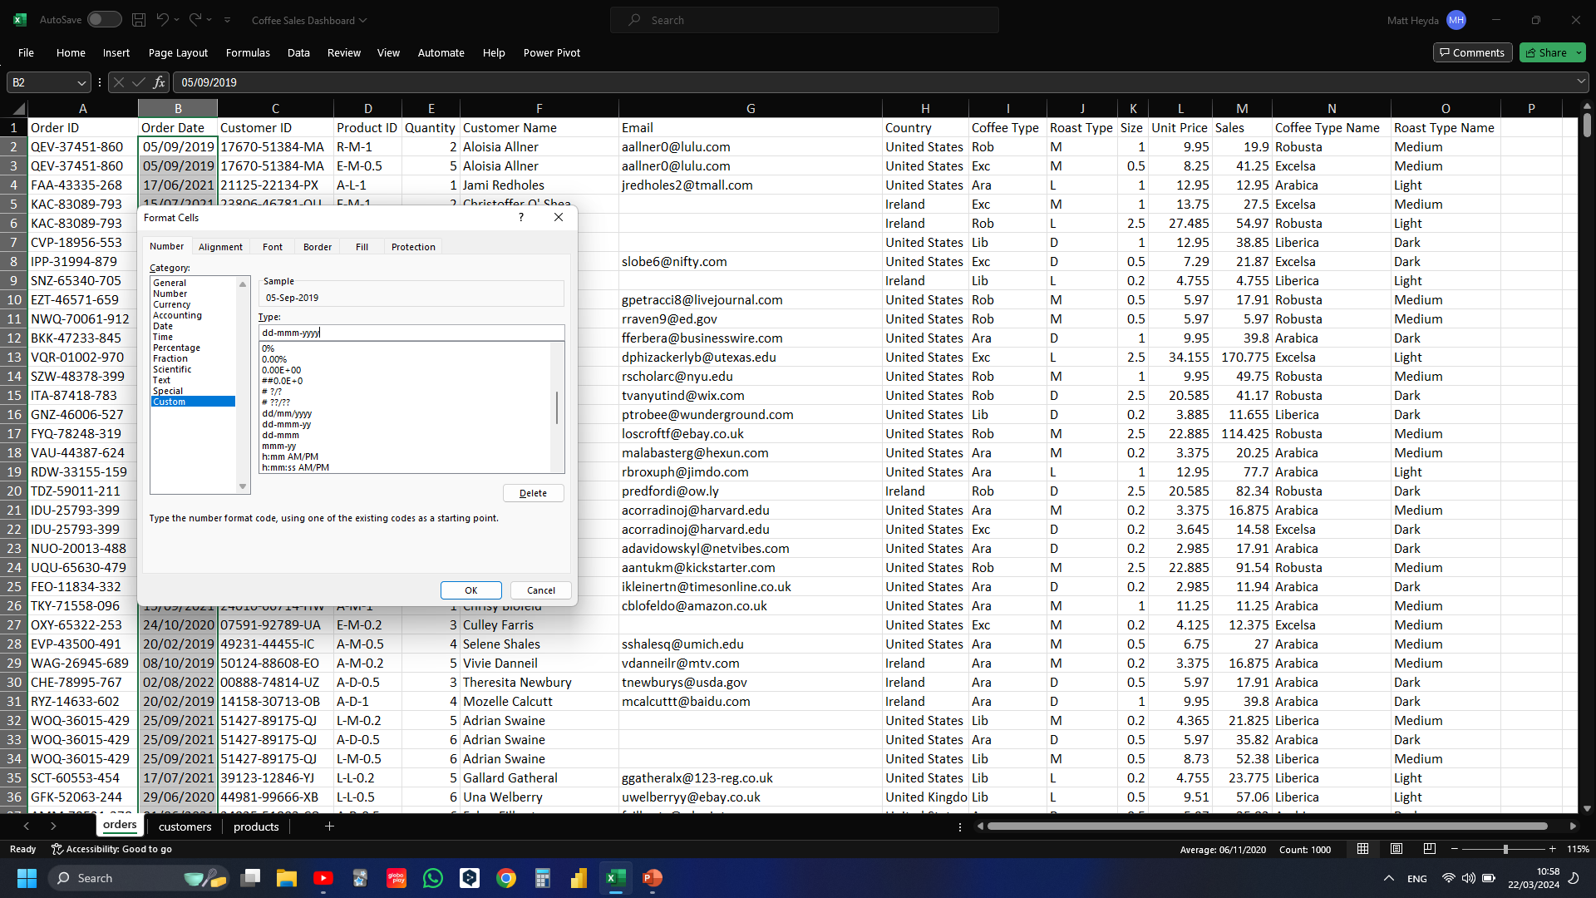
Notes:
Formatting the cells with a custom type “dd-mmm-yyyy”

Slide 14
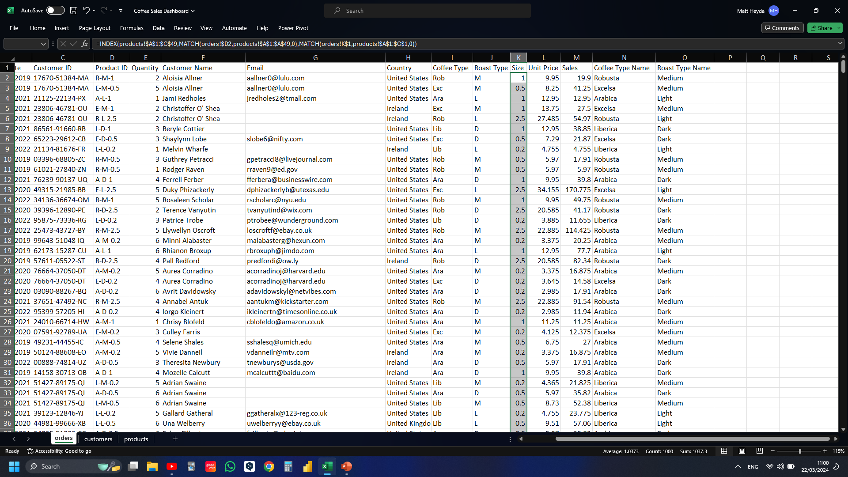
Notes:
Want to format the size column to include the metric “kg” e.g. 1 kg, 0.5 kg, etc.

Slide 15
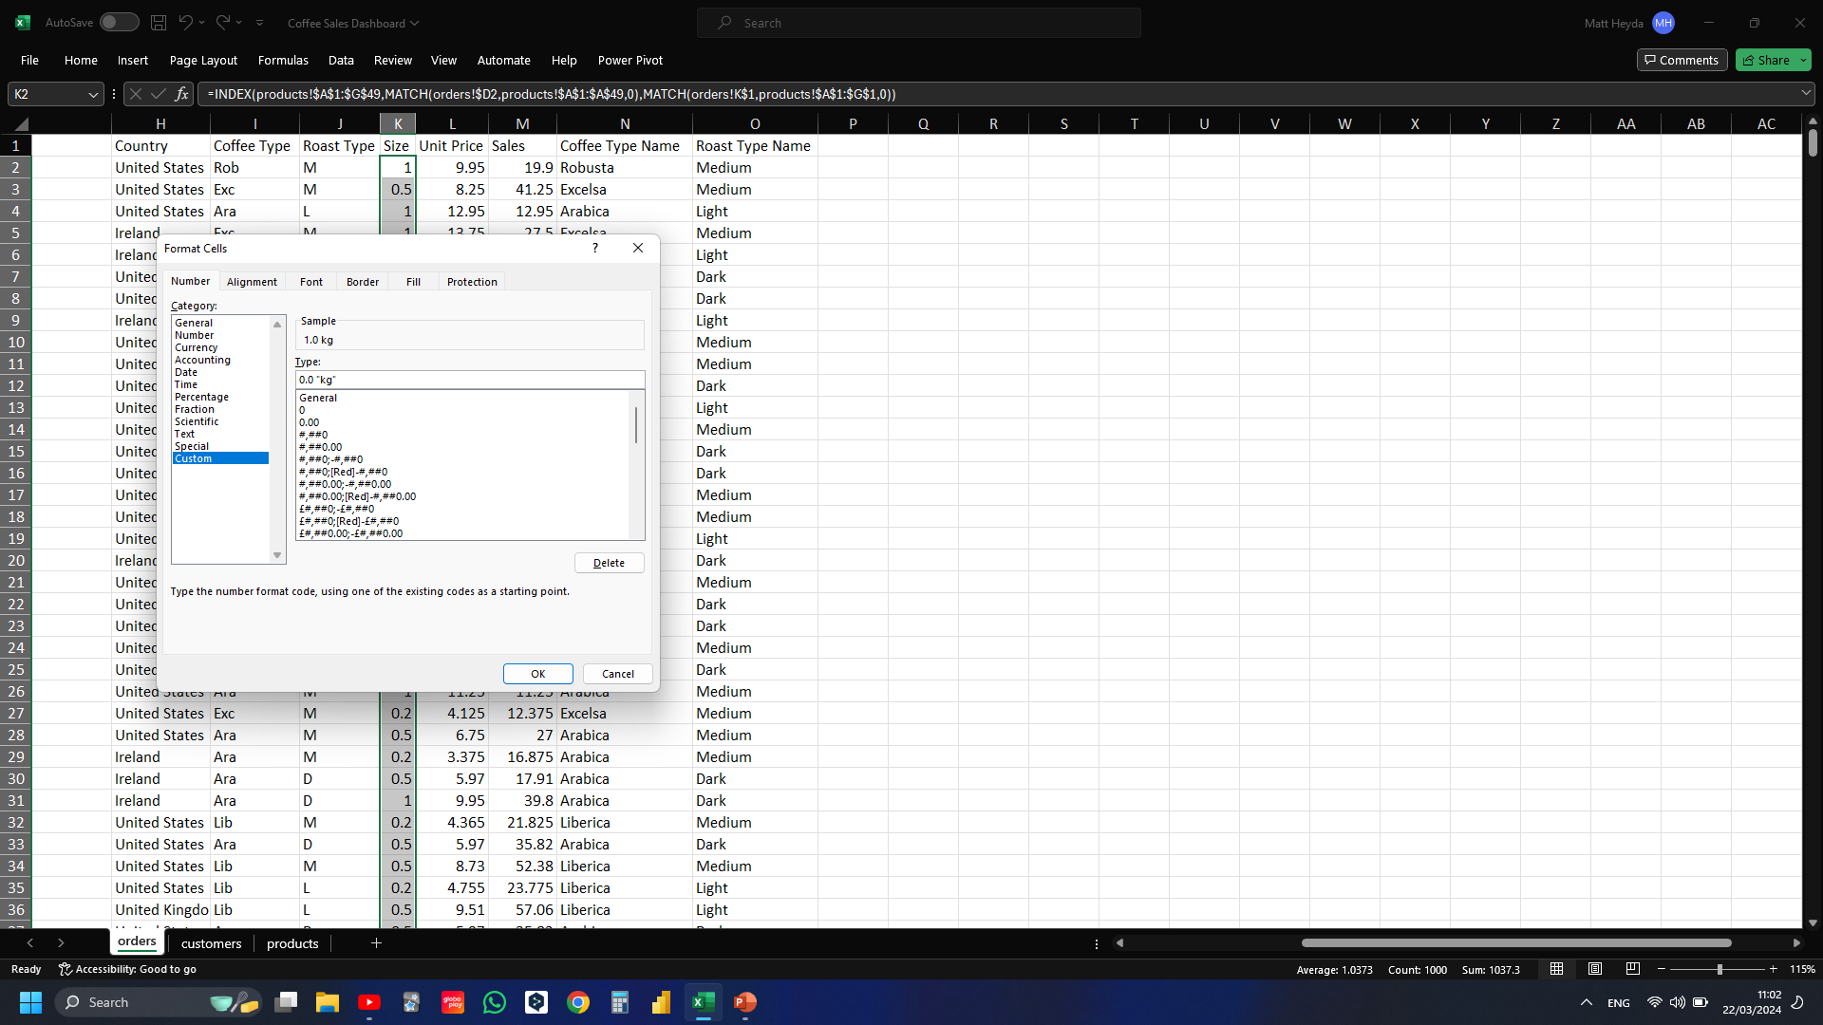
Notes:
Formatted the cells with a custom type following the format of one decimal place with “kg”

Slide 16
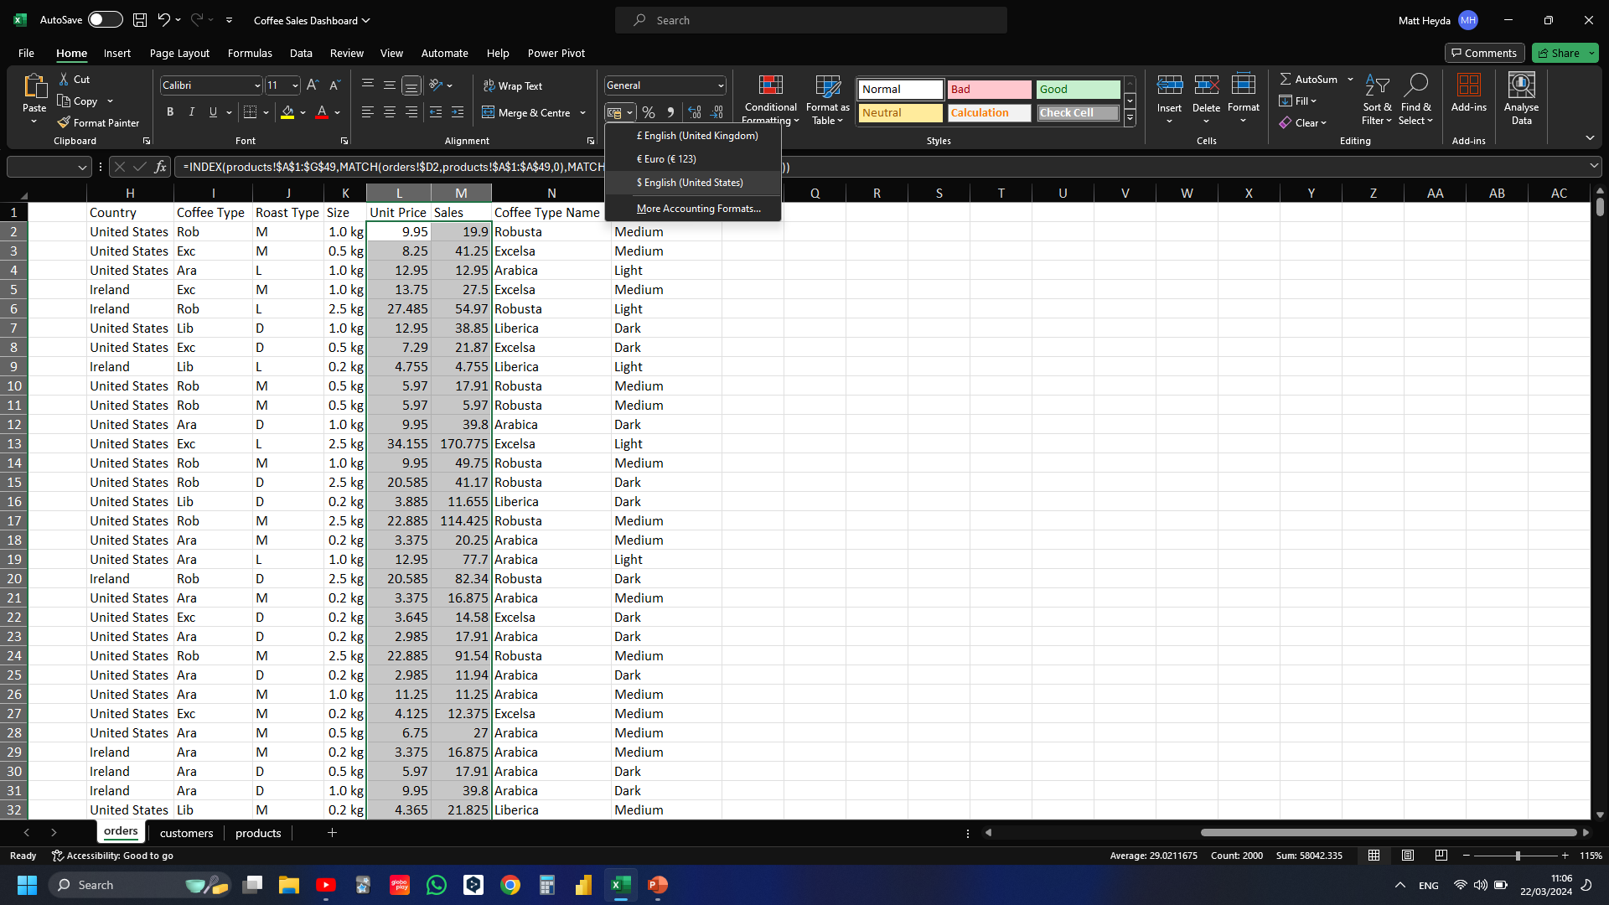
Notes:
Want to format the Unit Price and Sales columns to display as “$”

Slide 17
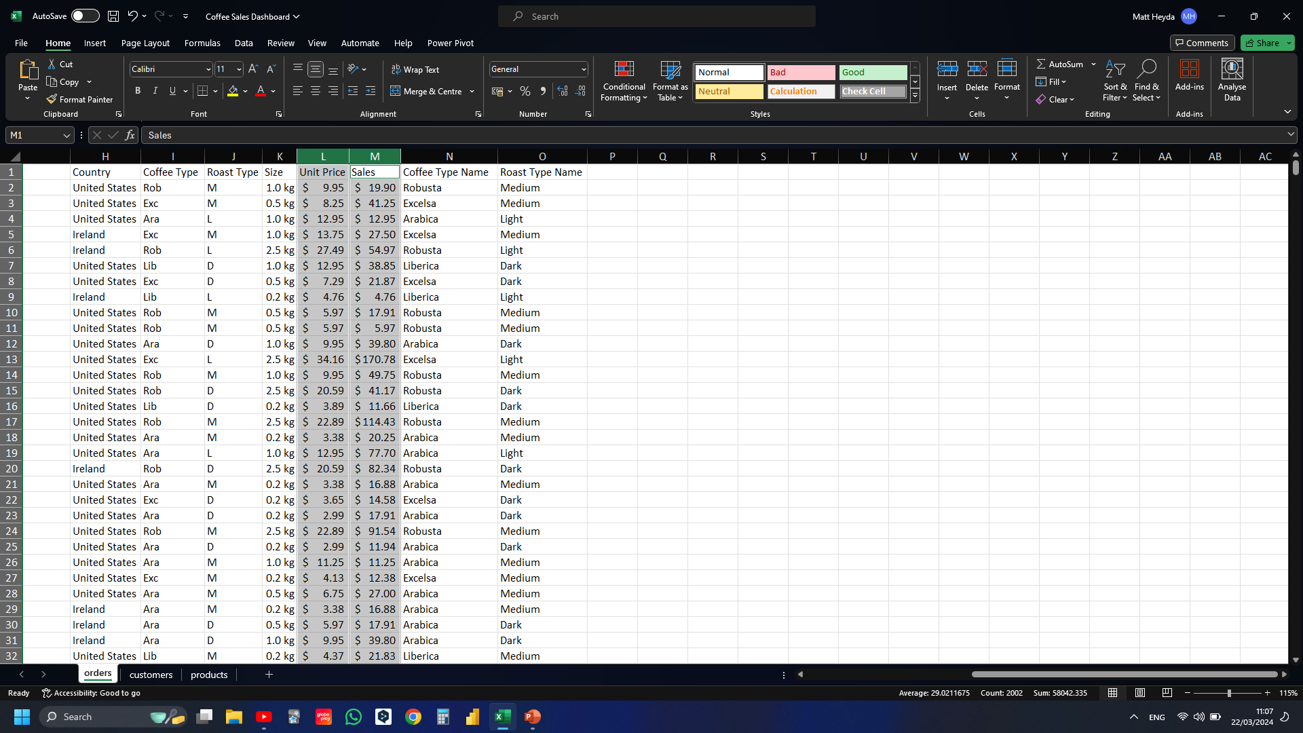

Slide 18
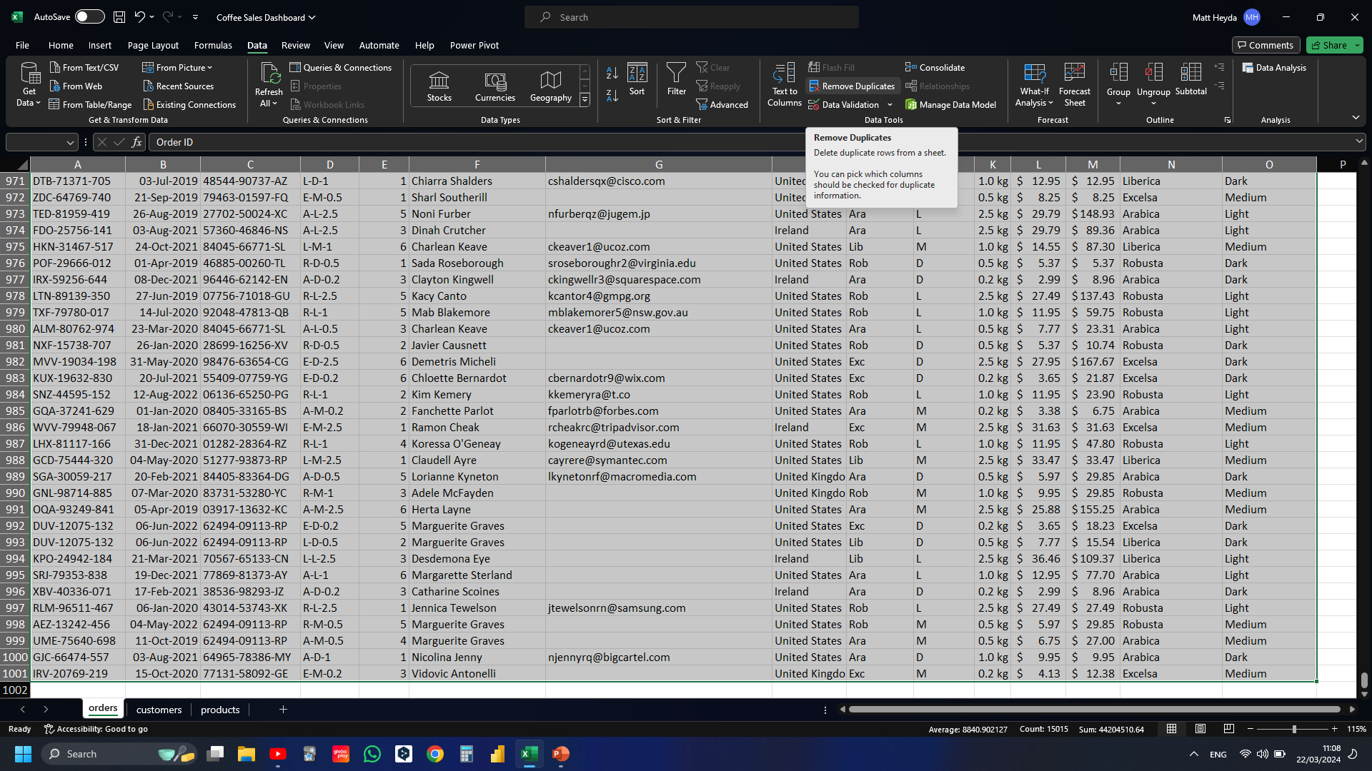
Notes:
Want to check for and remove any duplicates

Slide 19
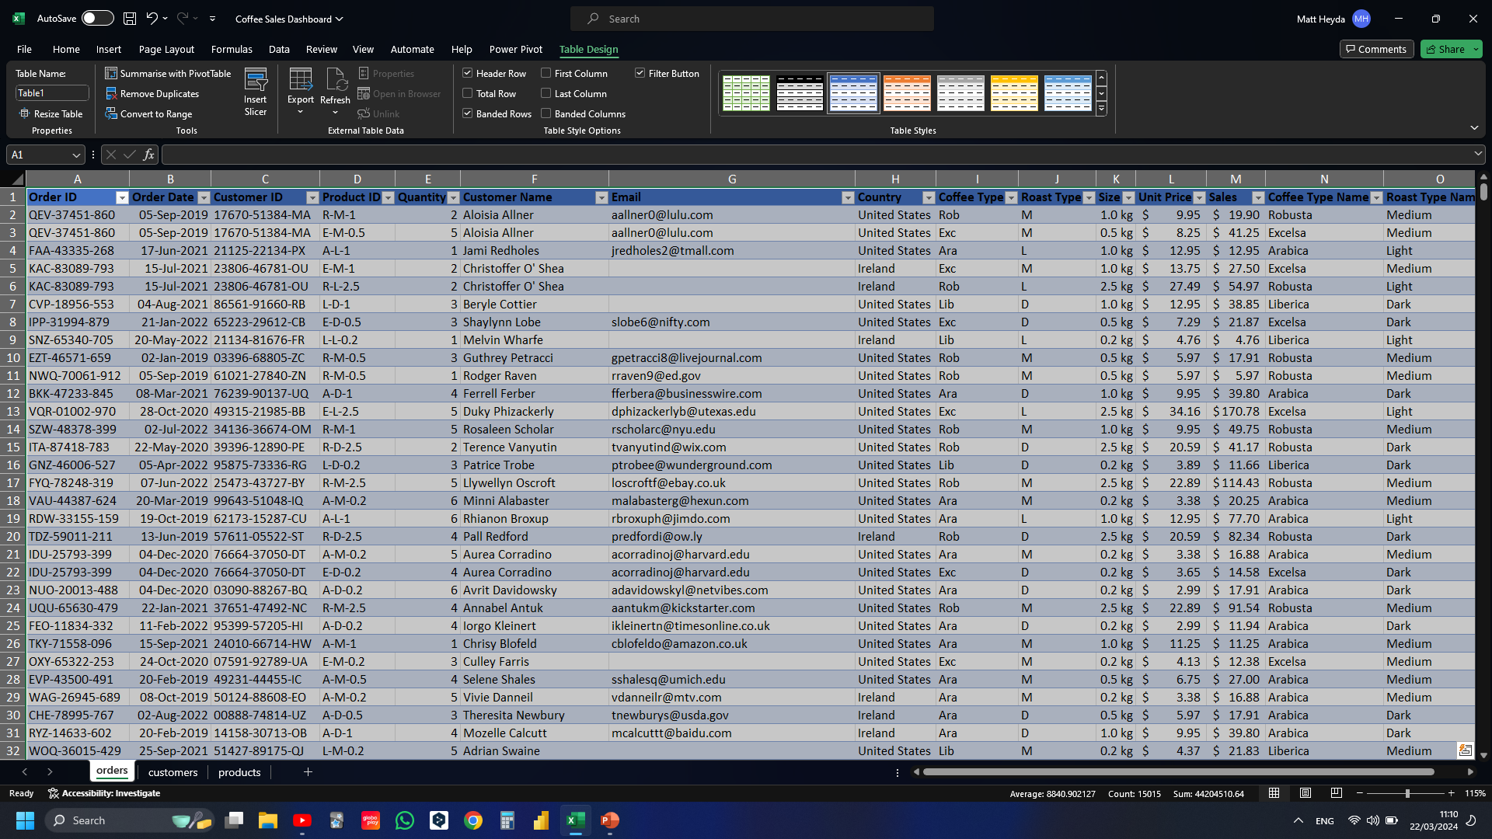
Notes:
Convert range to table (ctrl + t) so that I can easily update pivot chart data down the road

Slide 20
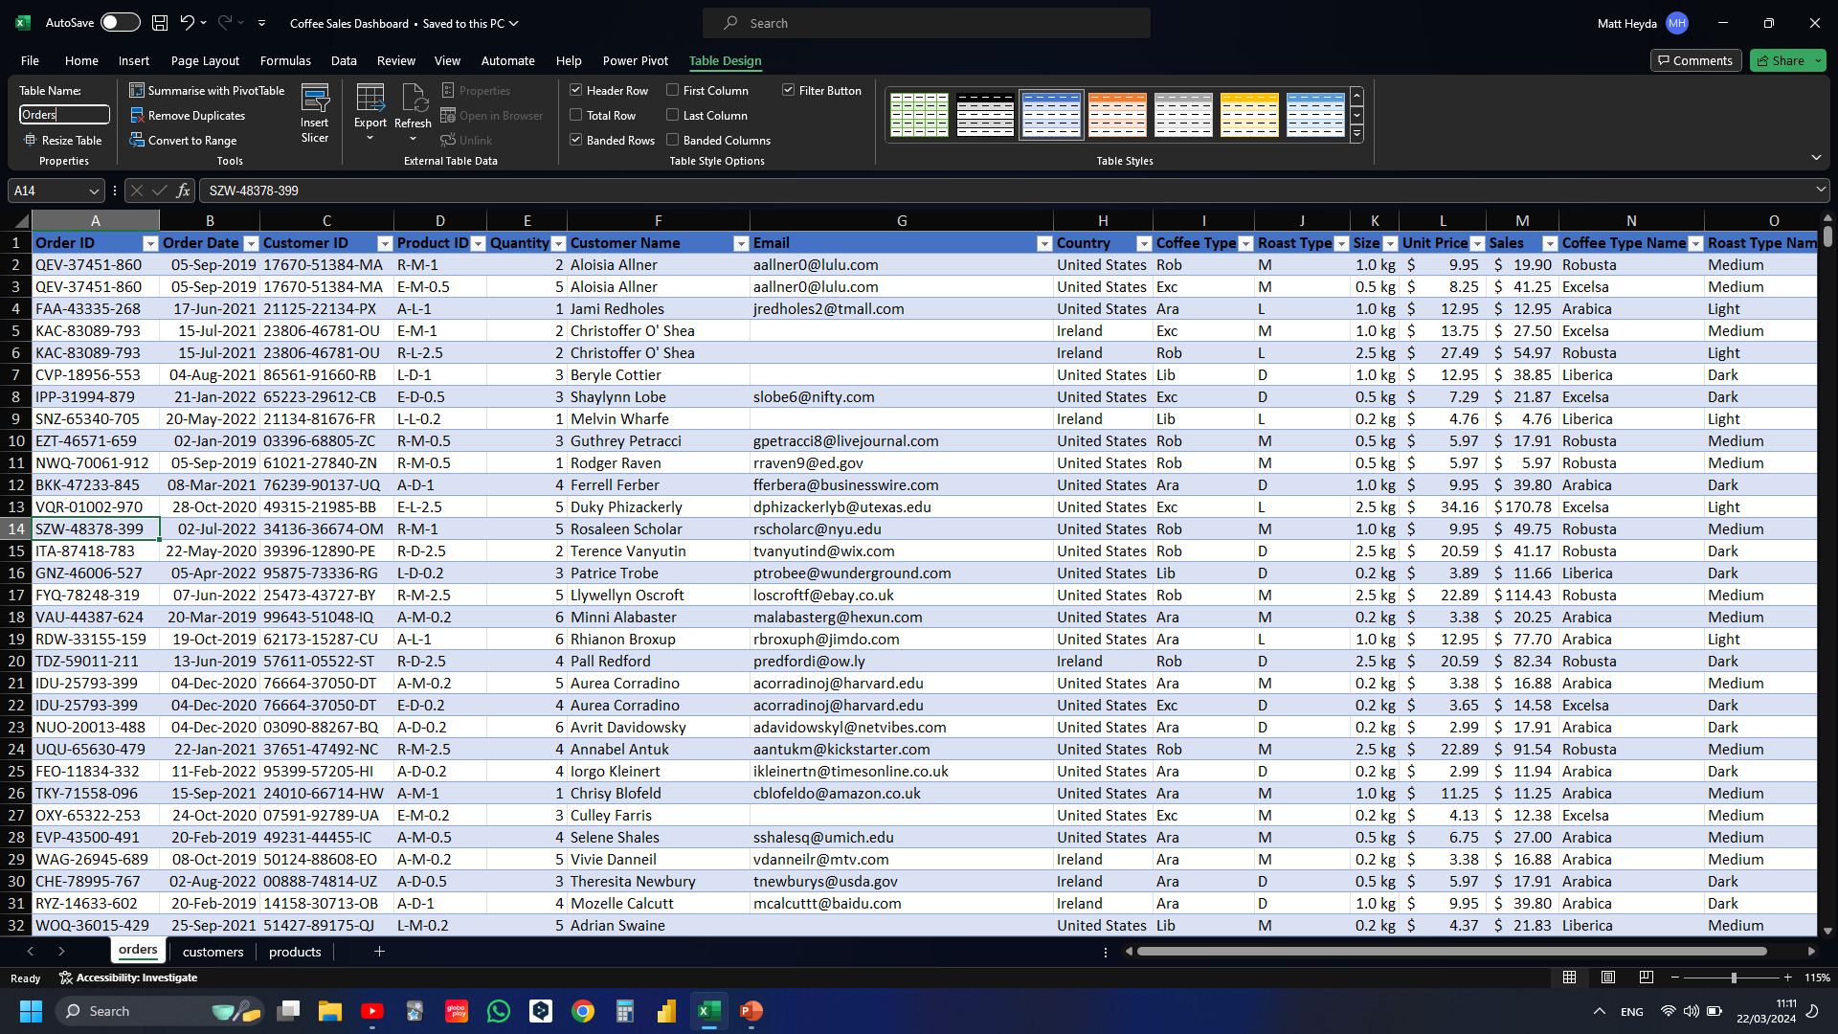
Notes:
Giving table meaningful name

Slide 21
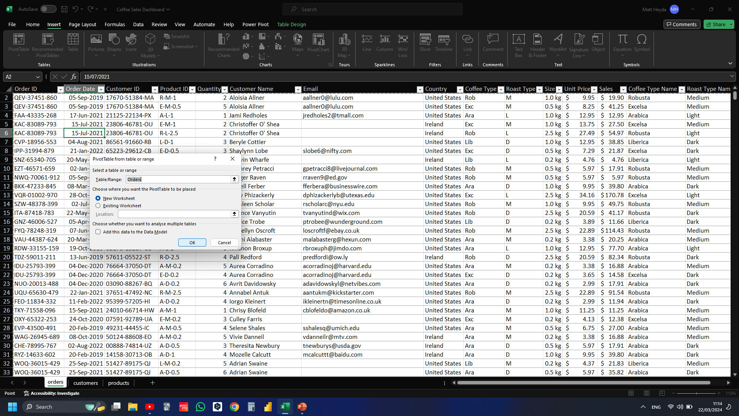
Notes:
Inserting pivot table from table

Slide 22
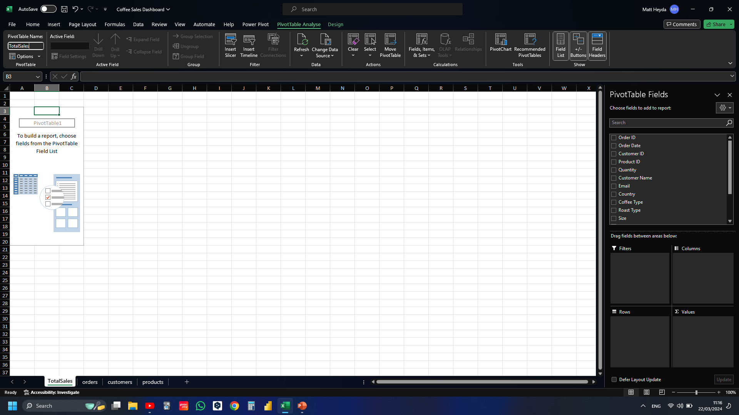
Notes:
Giving the pivot table a meaningful name

Slide 23
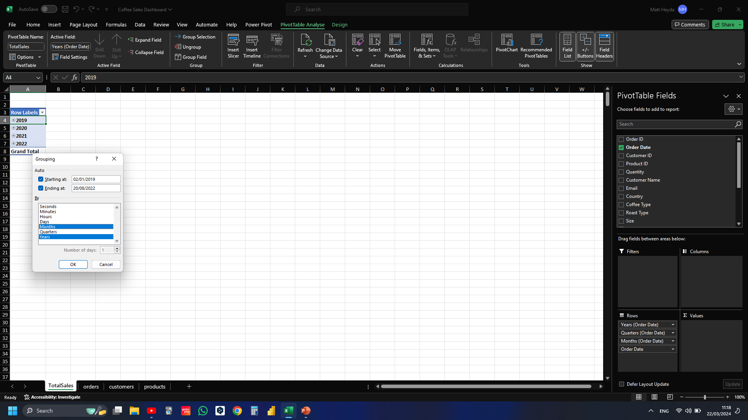
Notes:
Want to create a Total Sales over time chart, but first need to group the data by year and month in order to display both

Slide 24
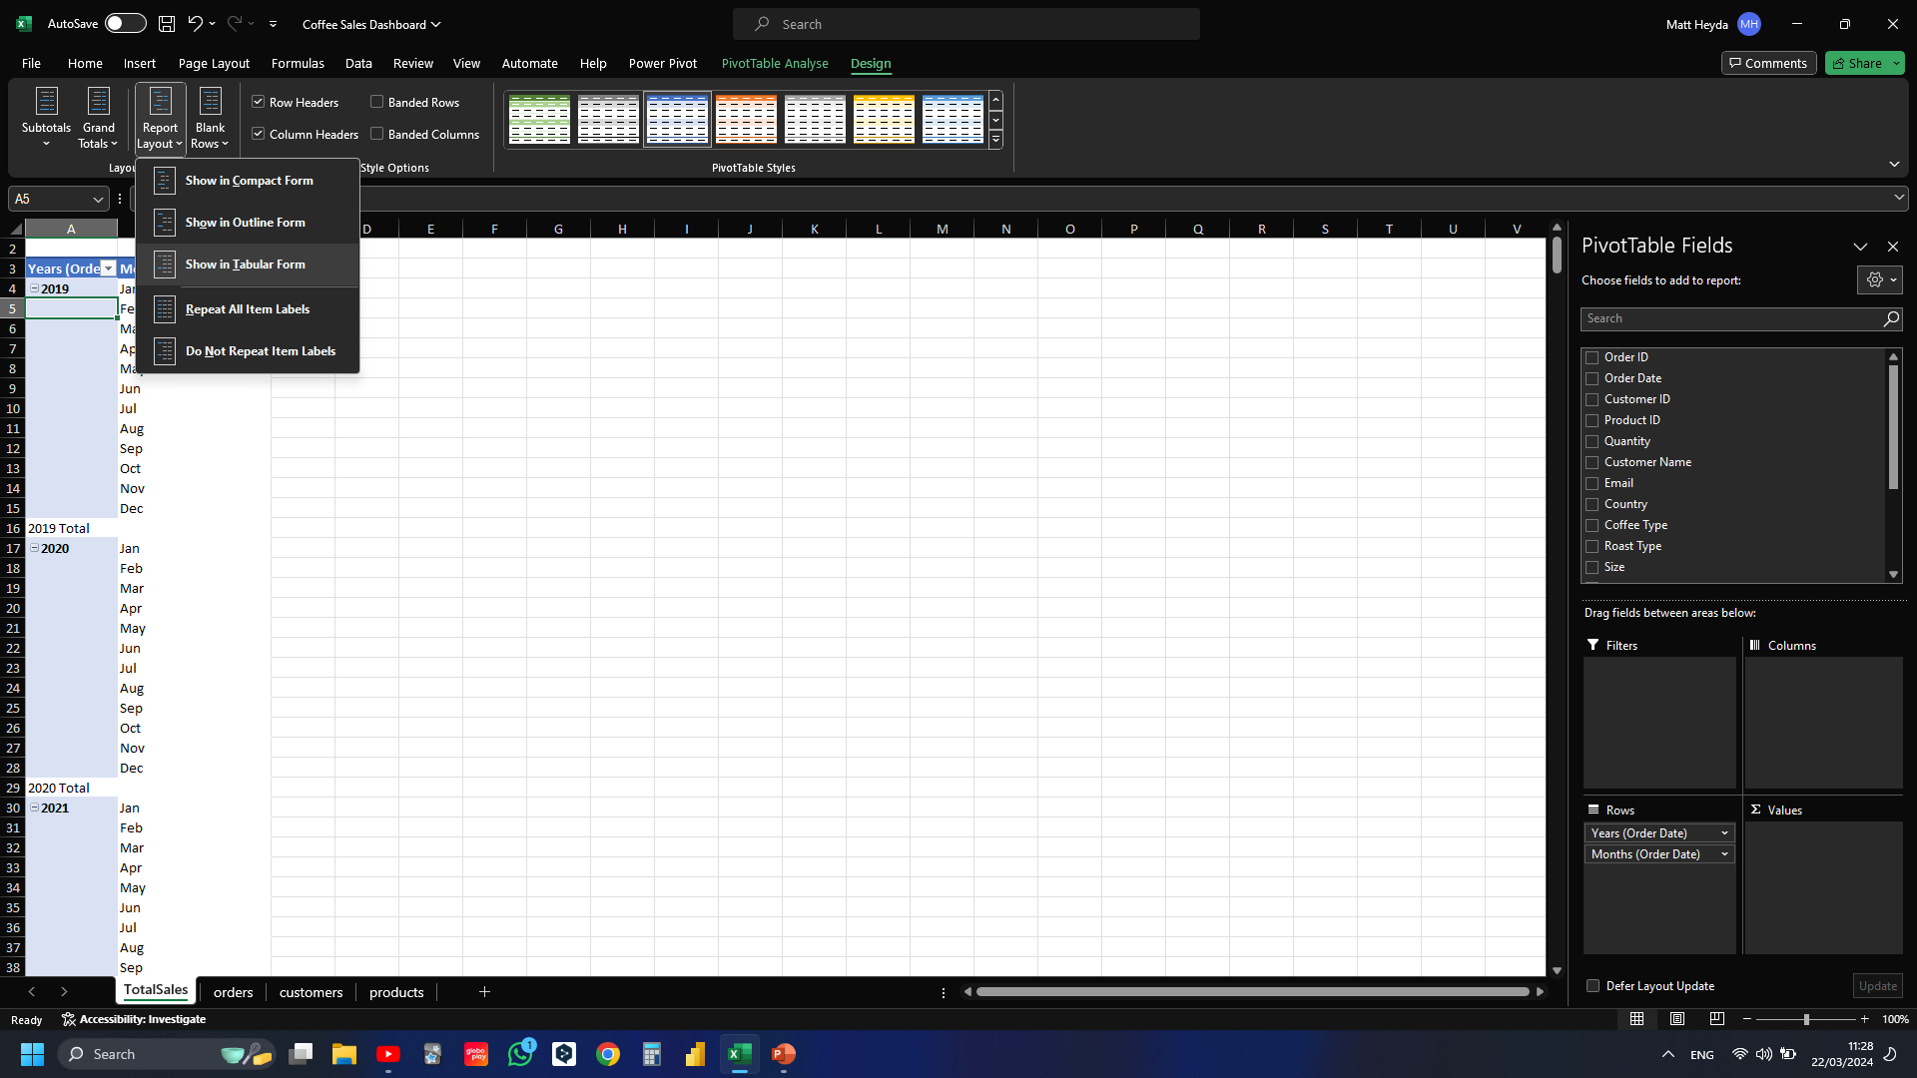
Notes:
Changed to show in tabular form

Slide 25
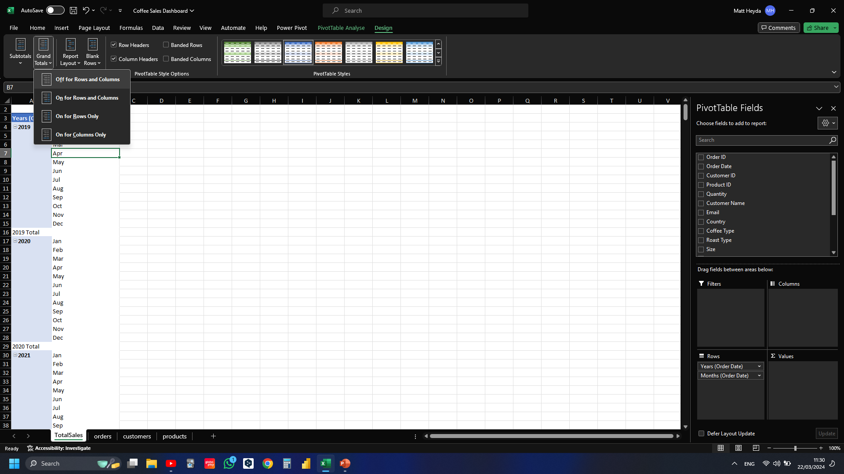
Notes:
Want to turn off grand totals and subtotals

Slide 26
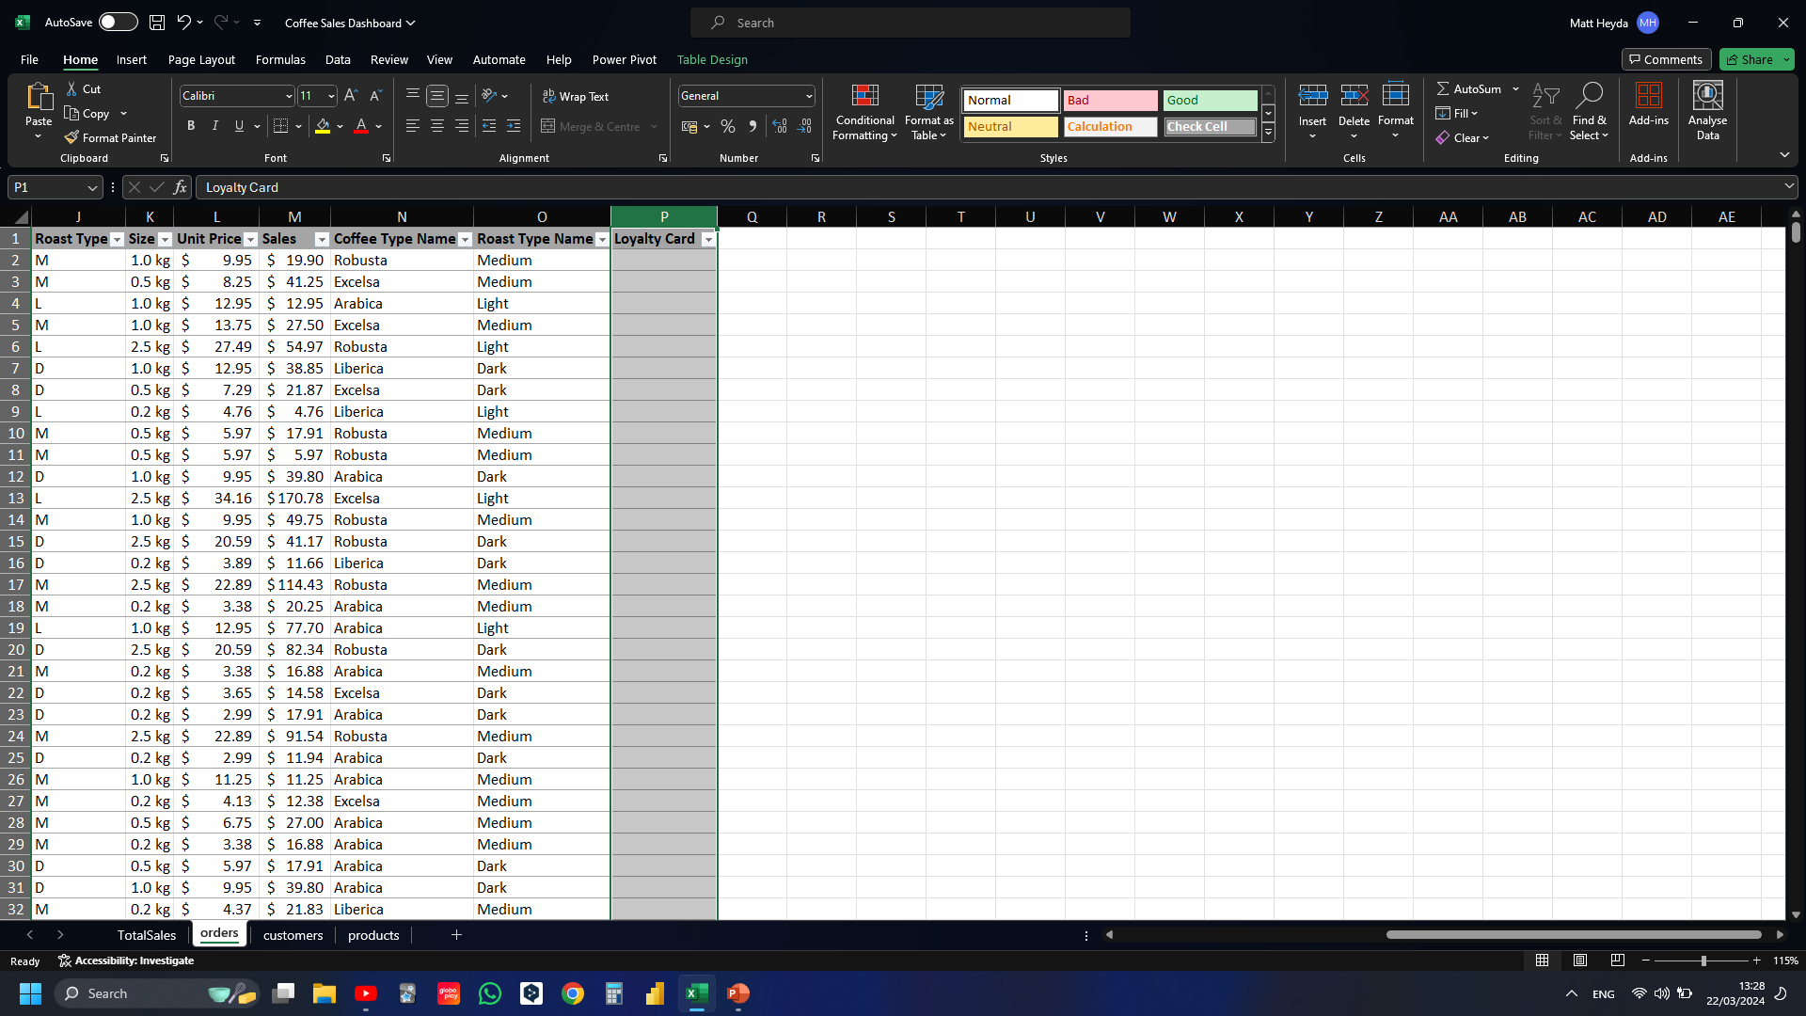
Notes:
Inserting new “loyalty card” column so that I can make a slicer

Slide 27
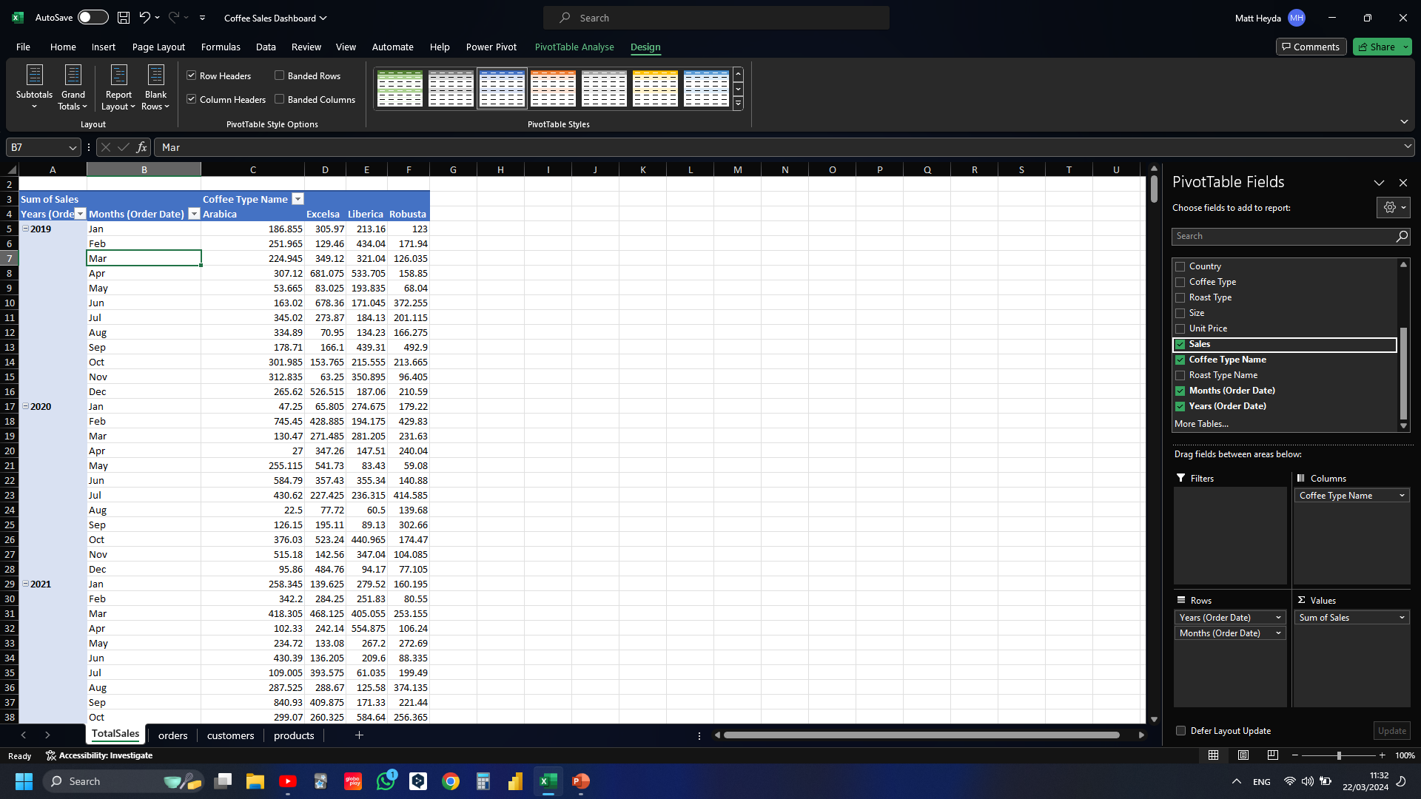
Notes:
Setting coffee type names as columns and the values as ‘sales’

Slide 28
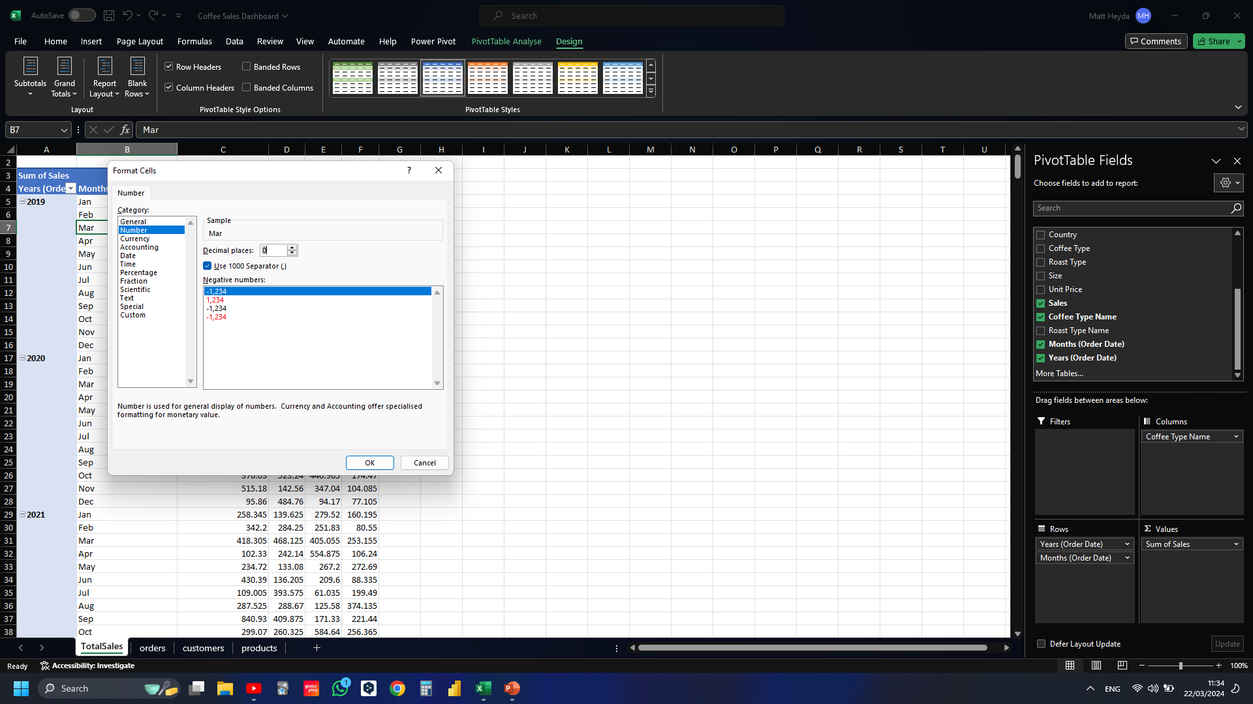
Notes:
Formatting Sales values to remove decimals

Slide 29
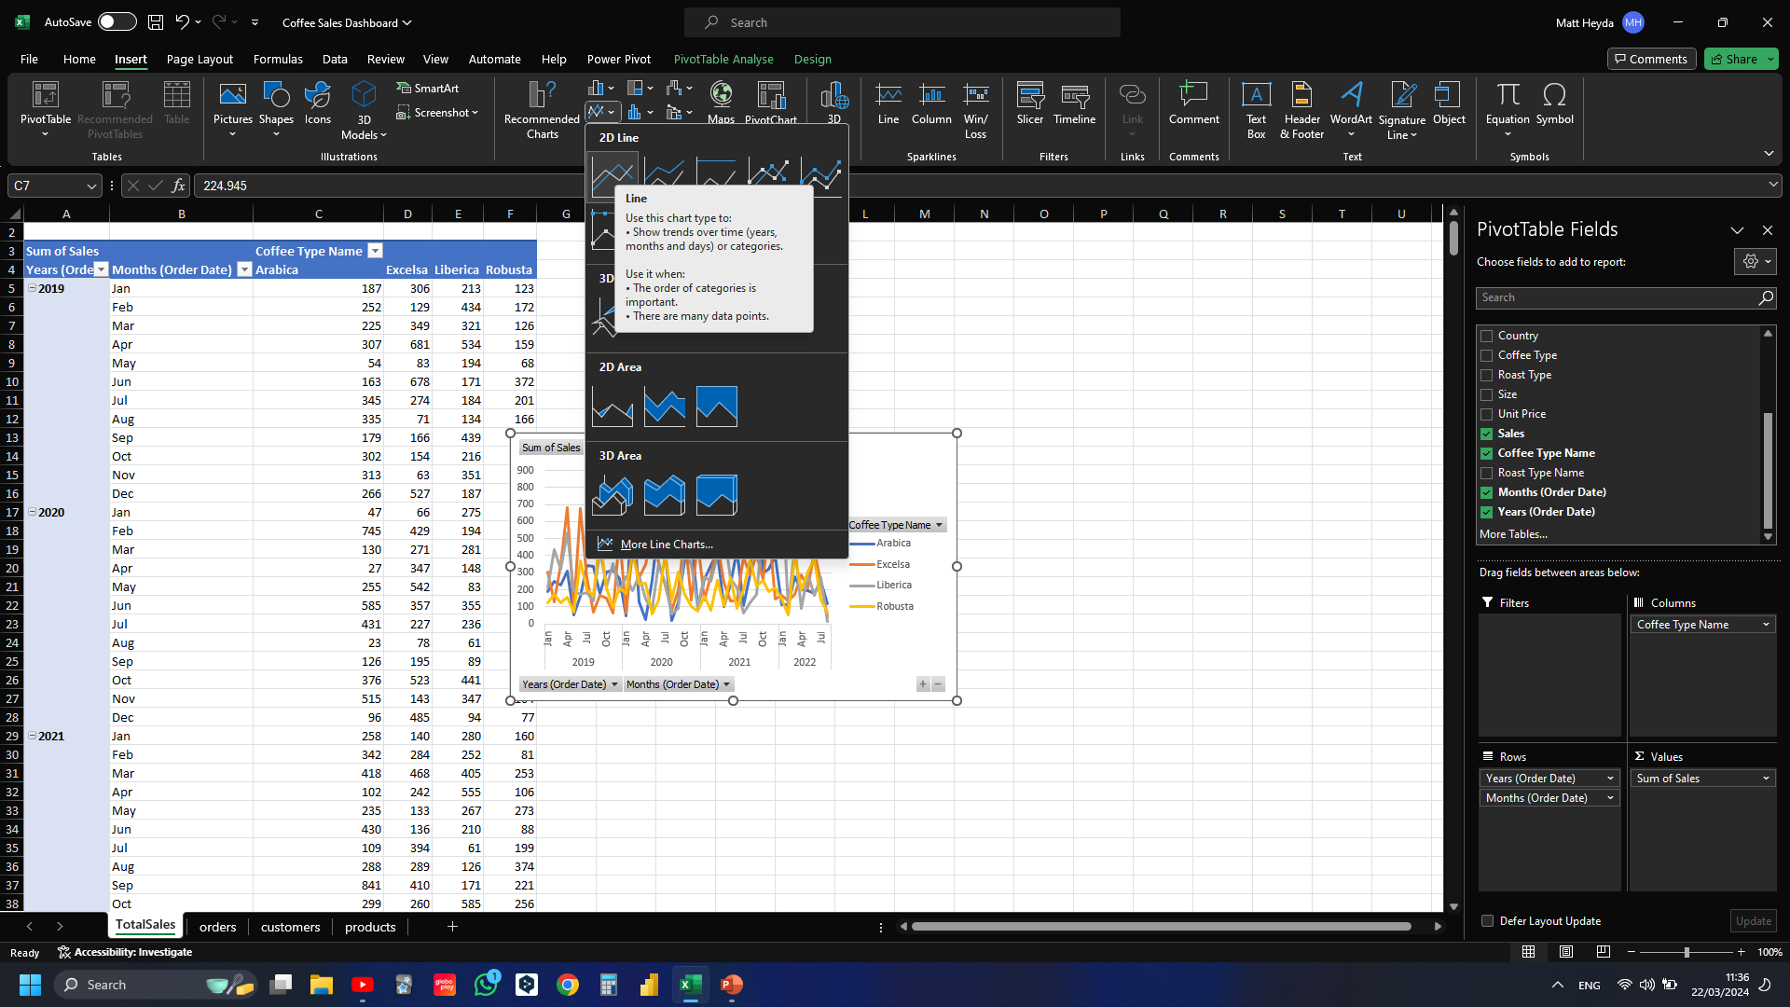
Notes:
Inserting line chart

Slide 30
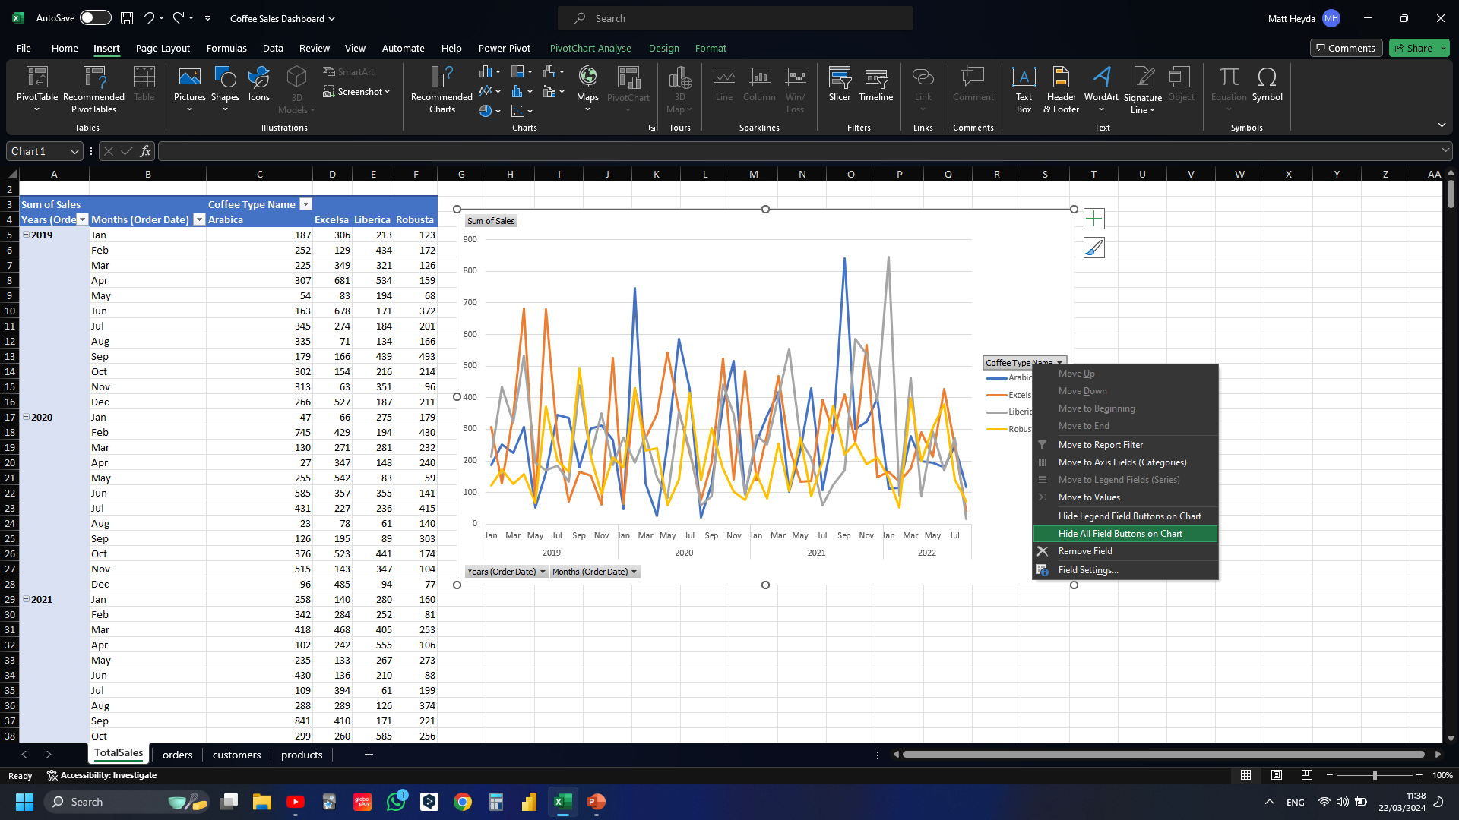
Notes:
Hiding all field buttons on chart

Slide 31
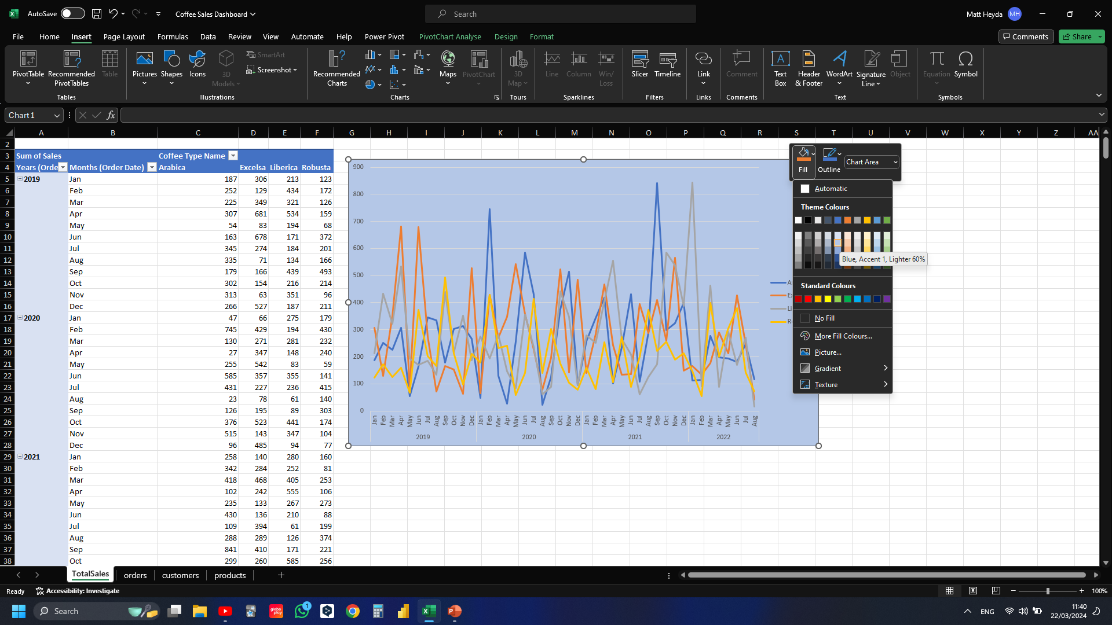
Notes:
Changing chart background colour

Slide 32
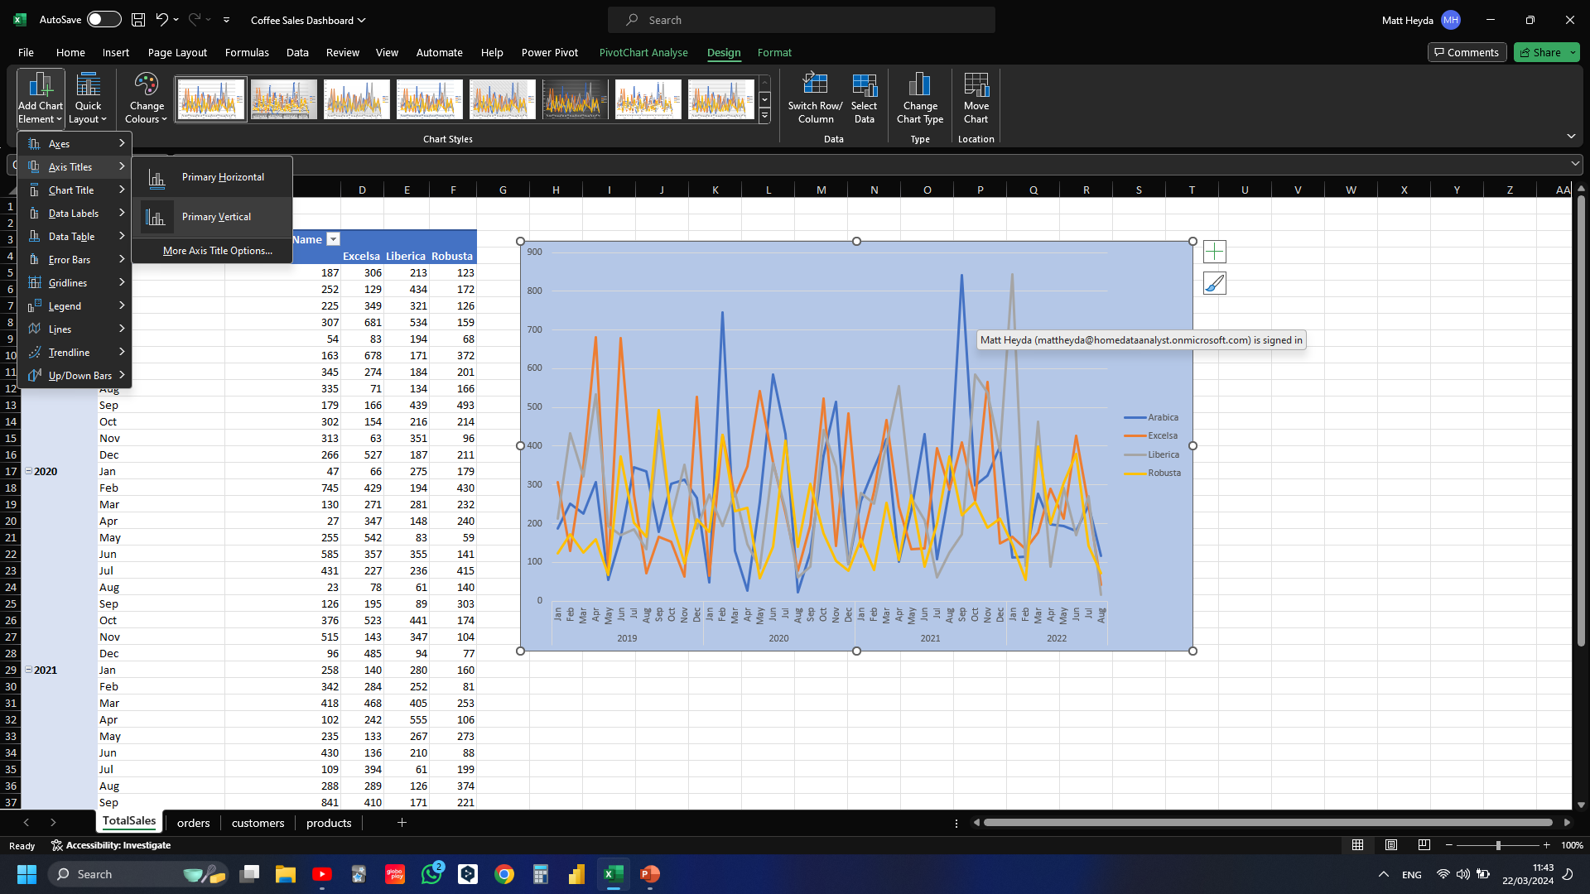
Notes:
Adding vertical axis title

Slide 33
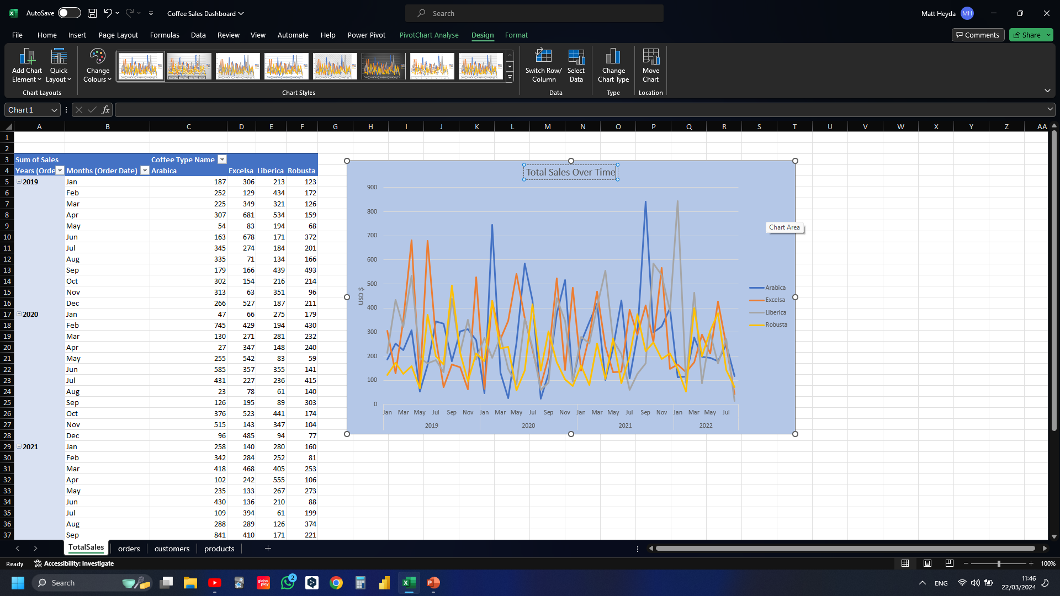
Notes:
Adding title

Slide 34
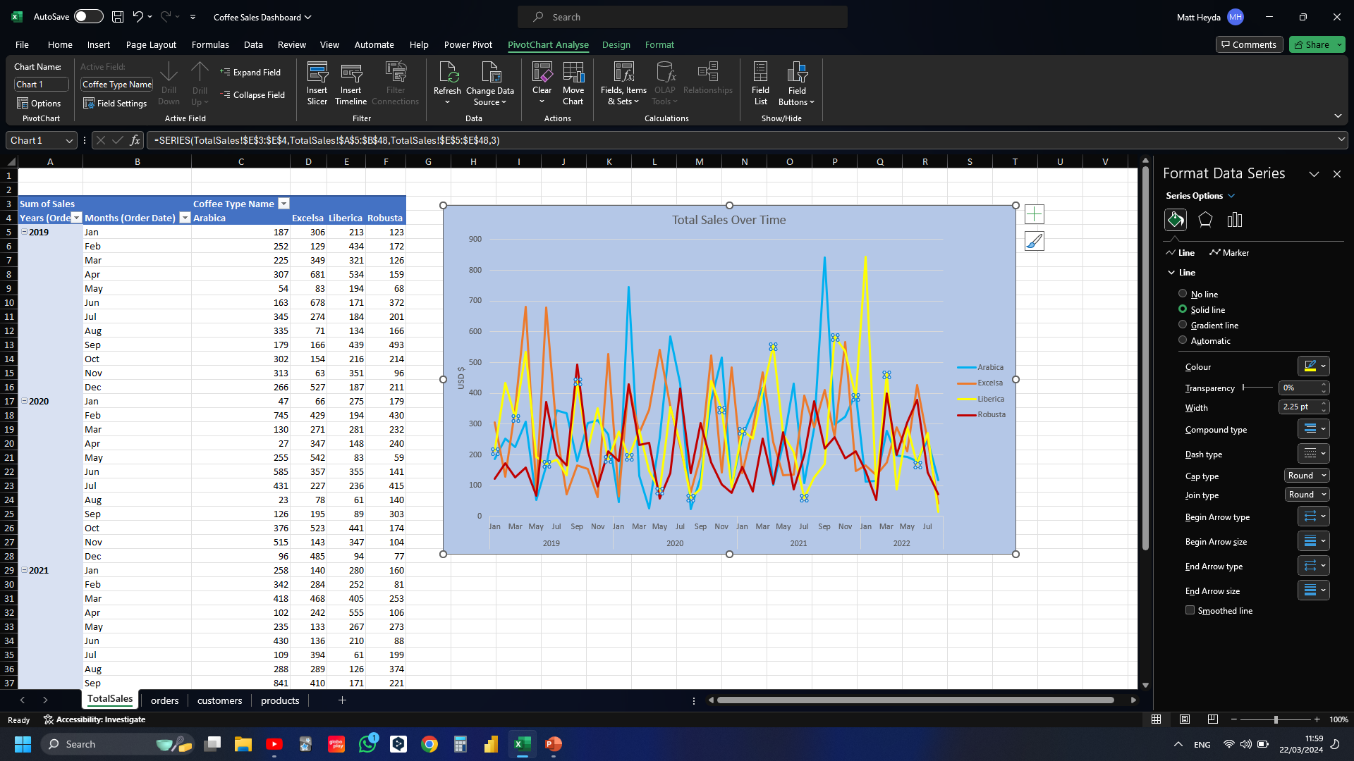
Notes:
Changes the line colours

Slide 35
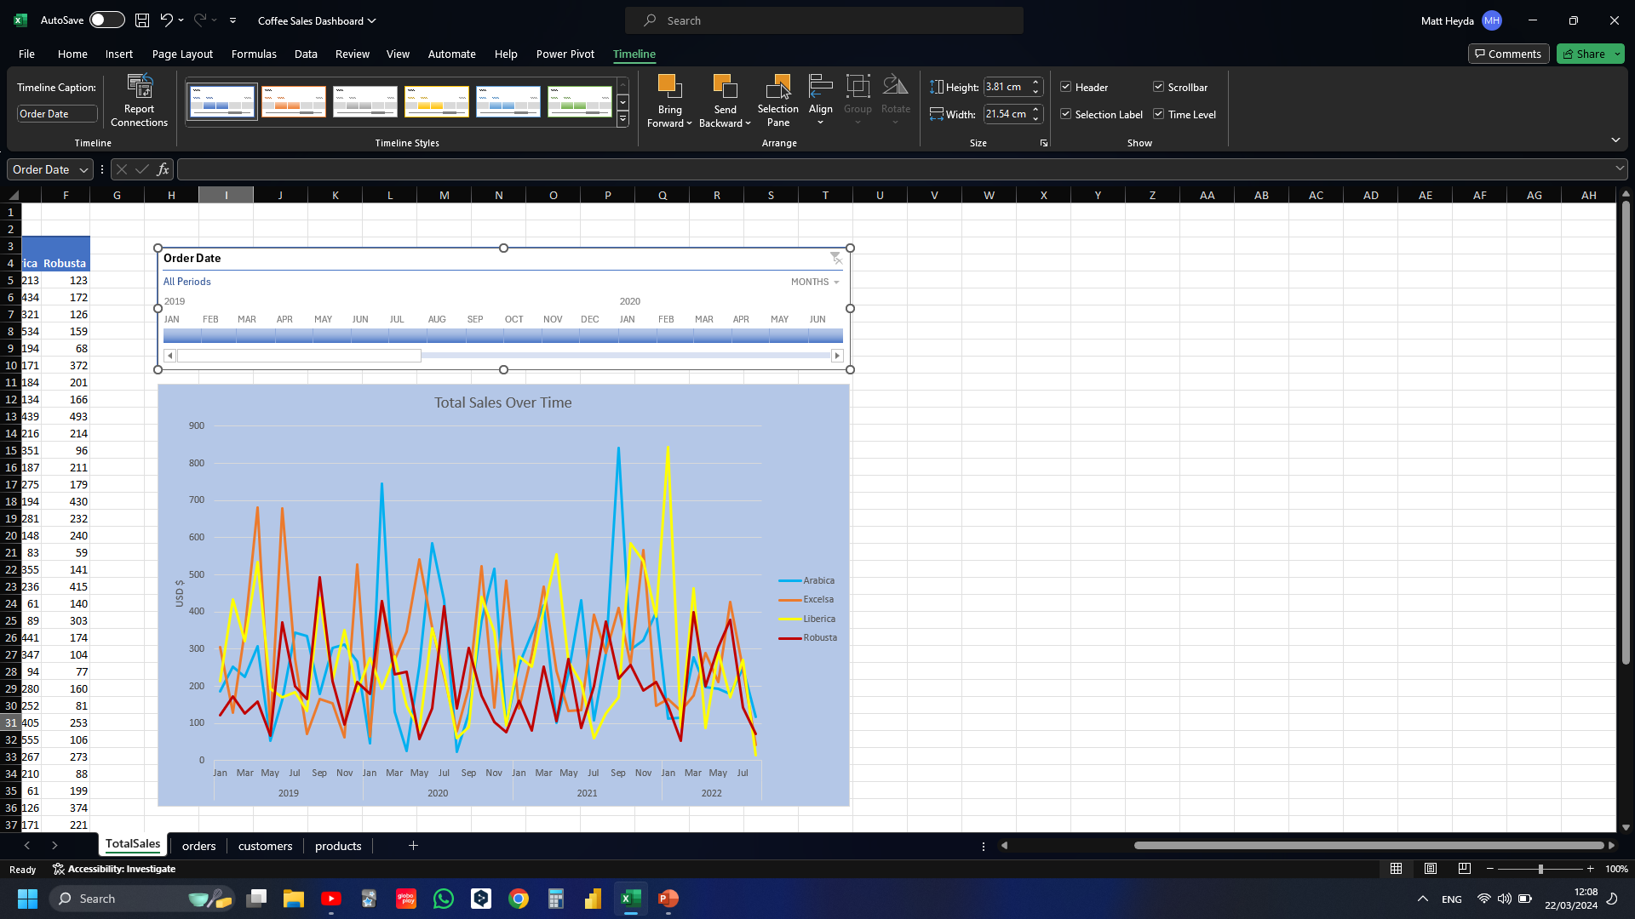
Notes:
Inserted timeline

Slide 36
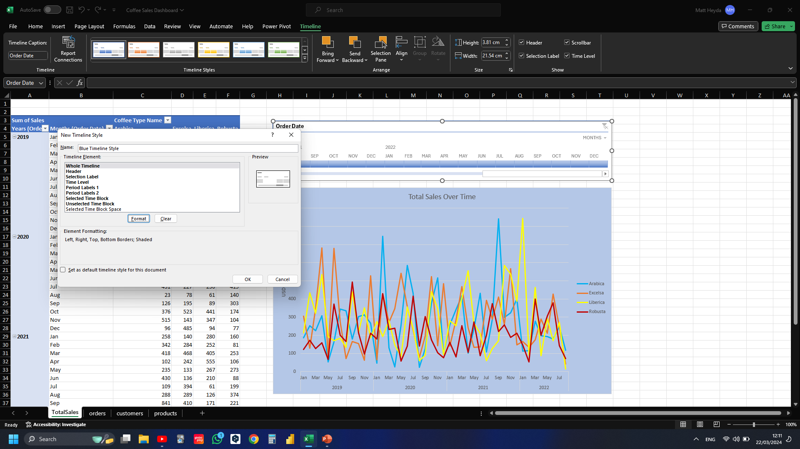
Notes:
Creating custom timeline style

Slide 37
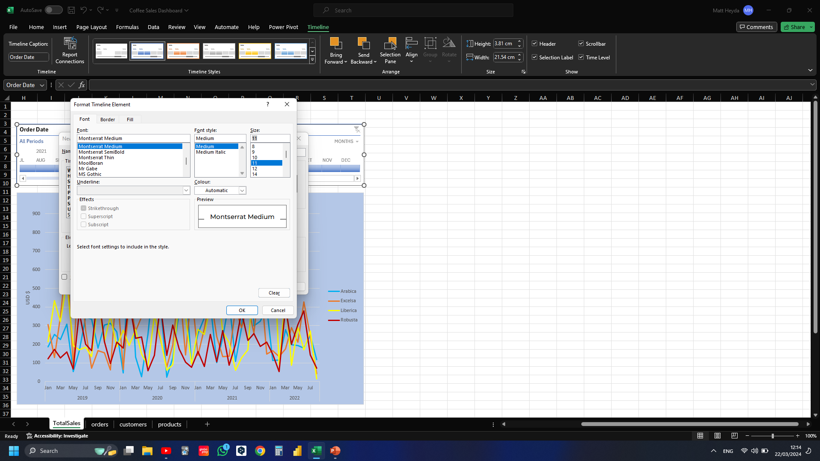
Notes:
Changing font, border and fill colours

Slide 38
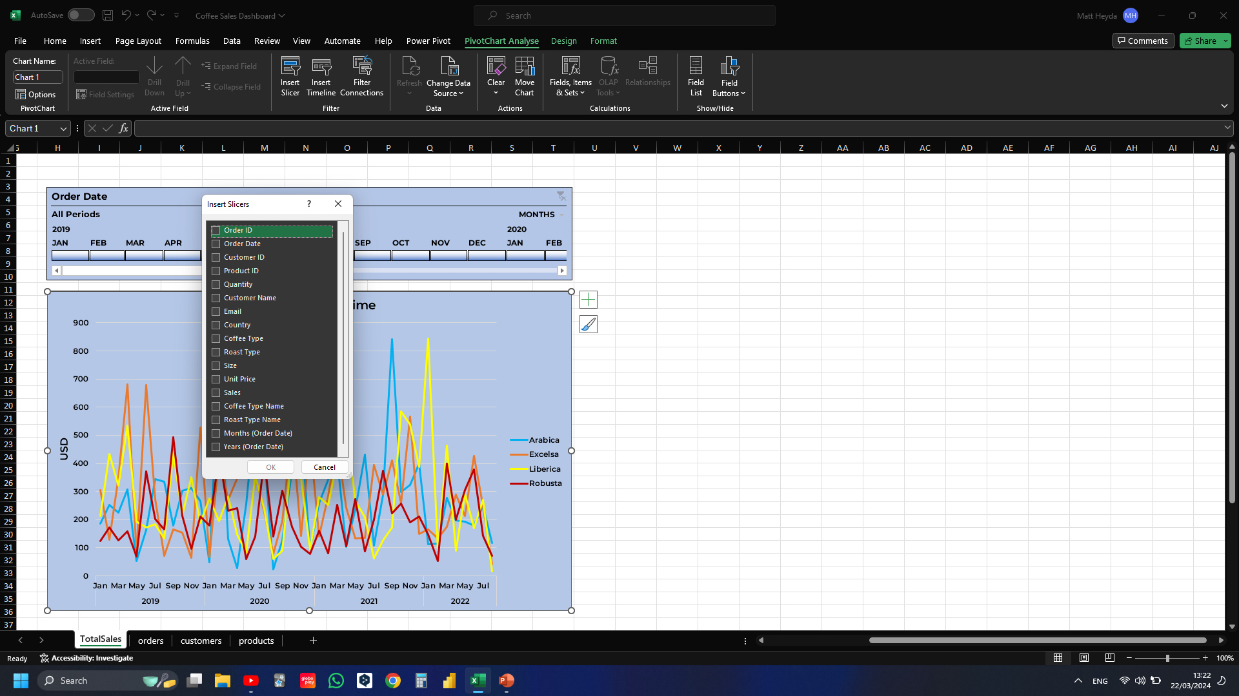
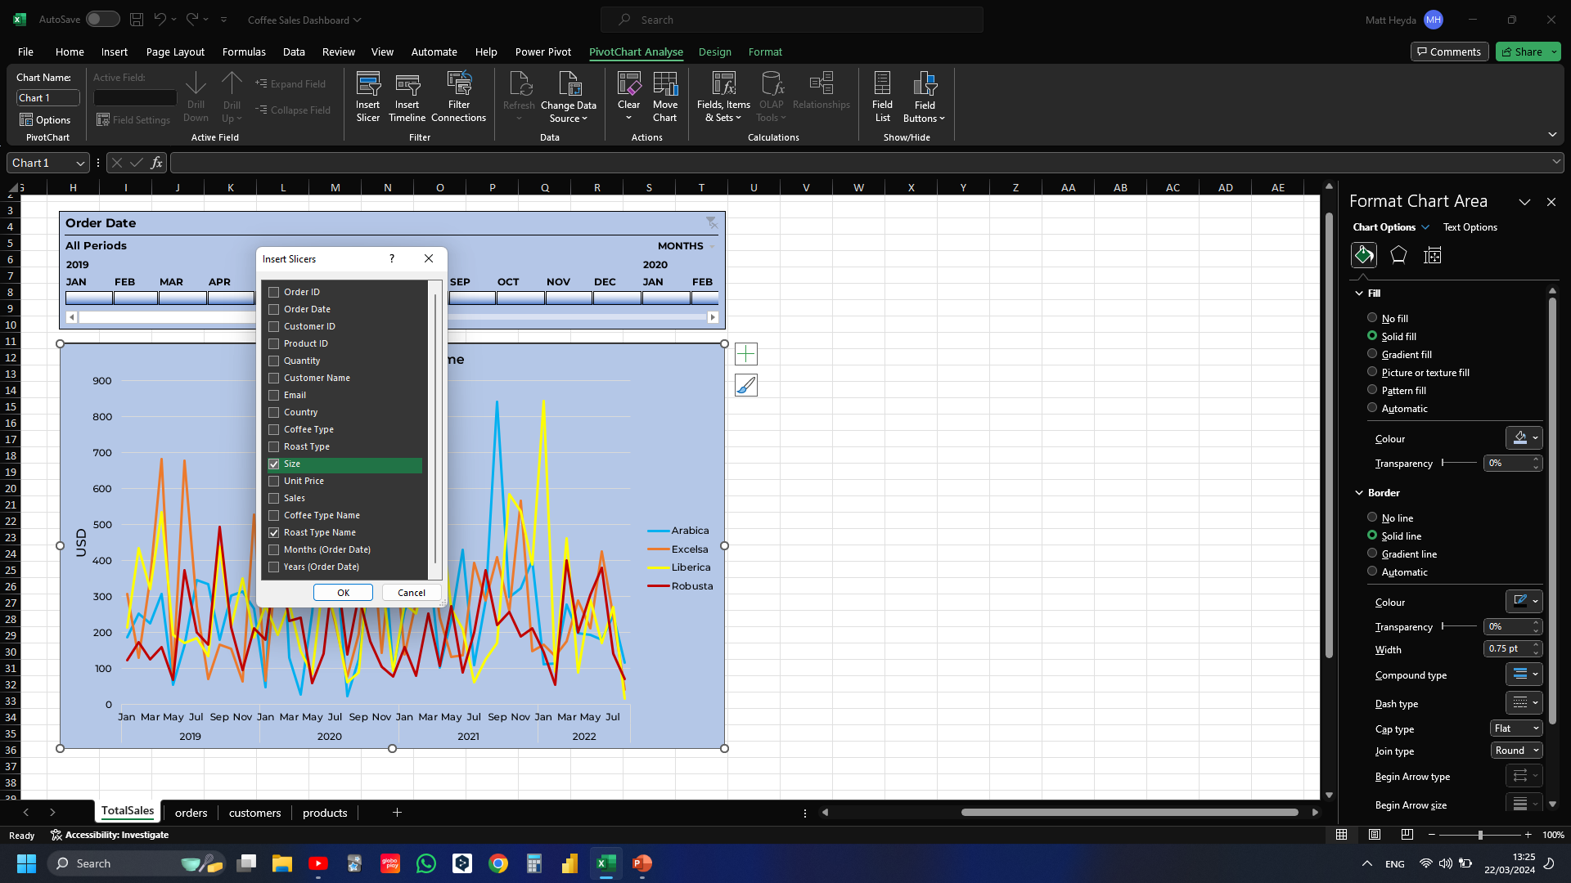
Notes:
Inserting slicers

Slide 39
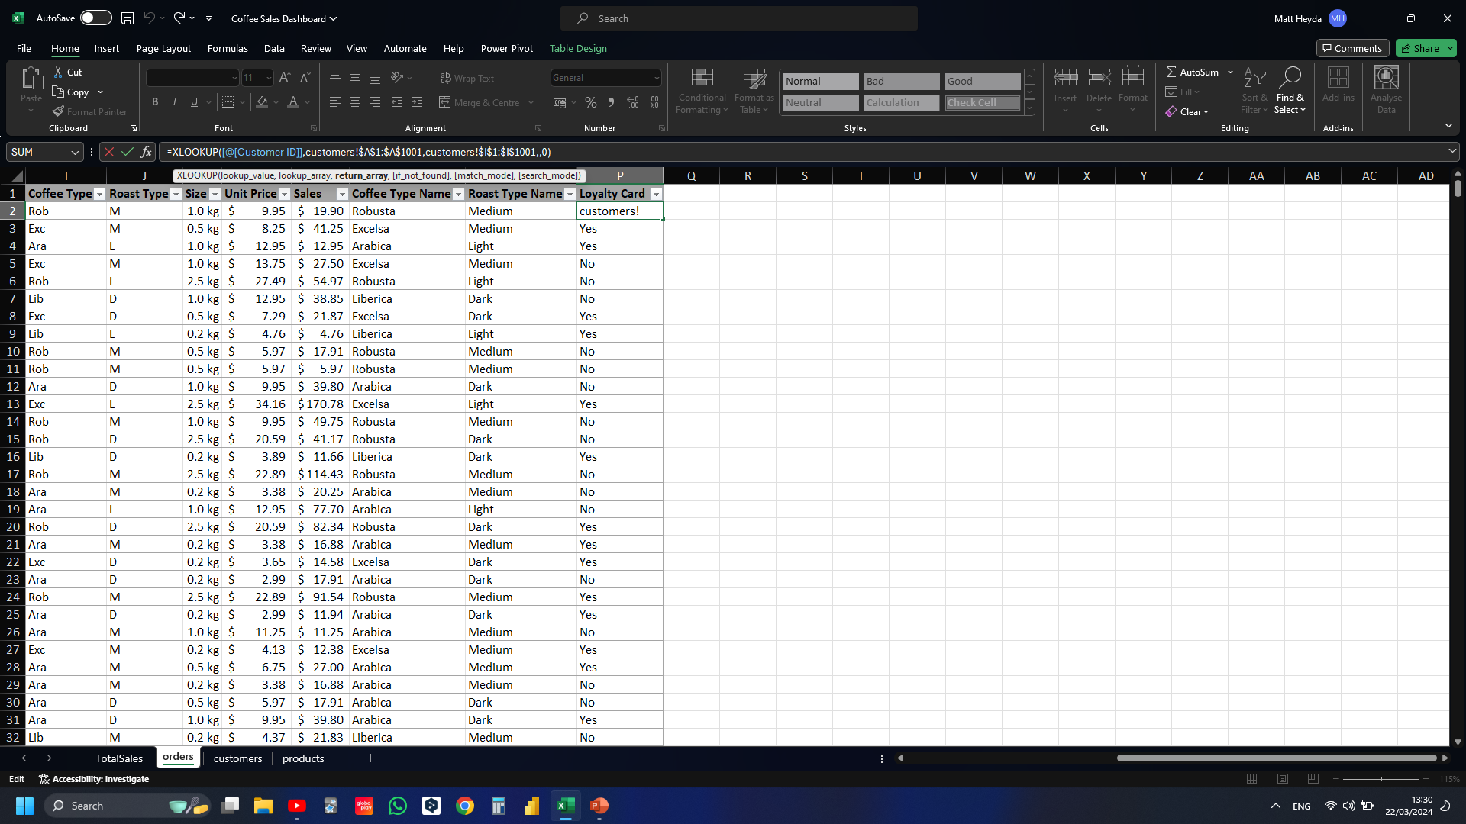
Notes:
Created new loyalty card column in order to make a loyalty card slicer for the dashboard. Used XLOOKUP to fill columns

Slide 40
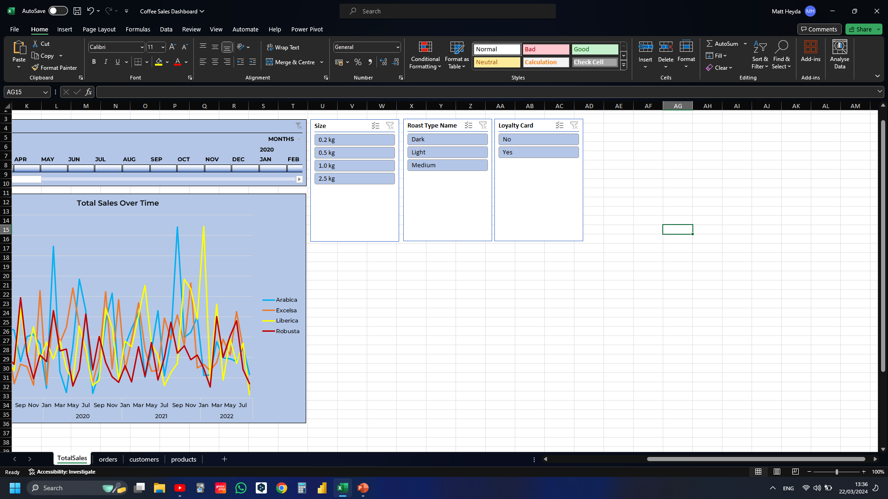
Notes:
Added loyalty card slicer

Slide 41
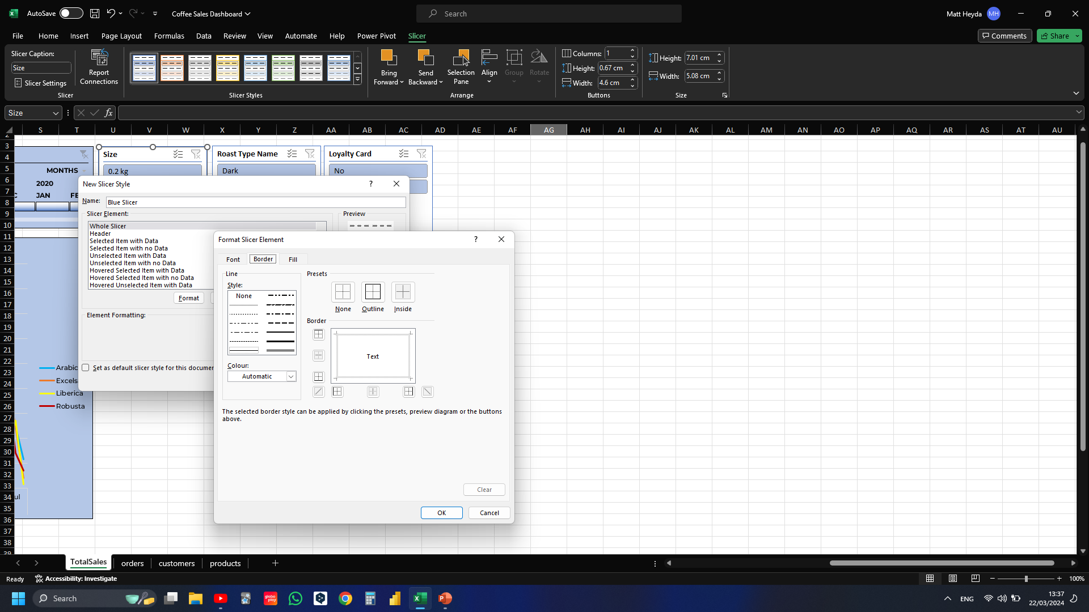
Notes:
Customising Slicer style

Slide 42
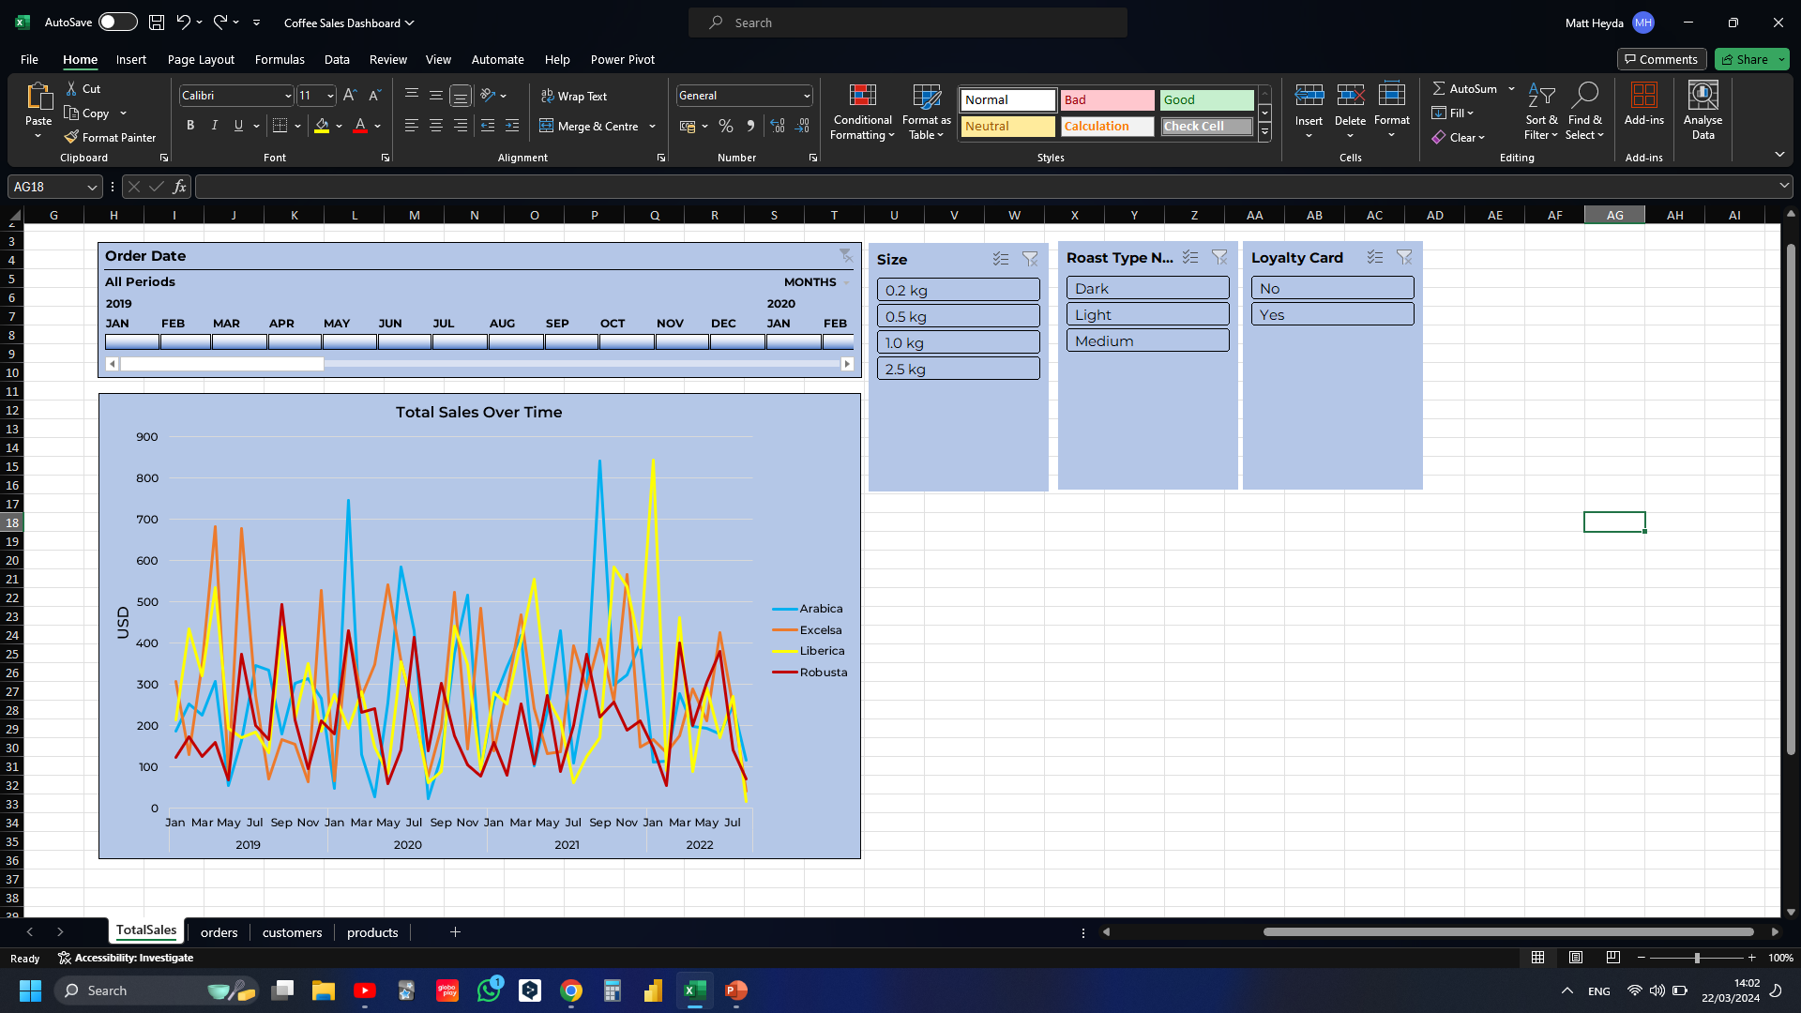

Slide 43
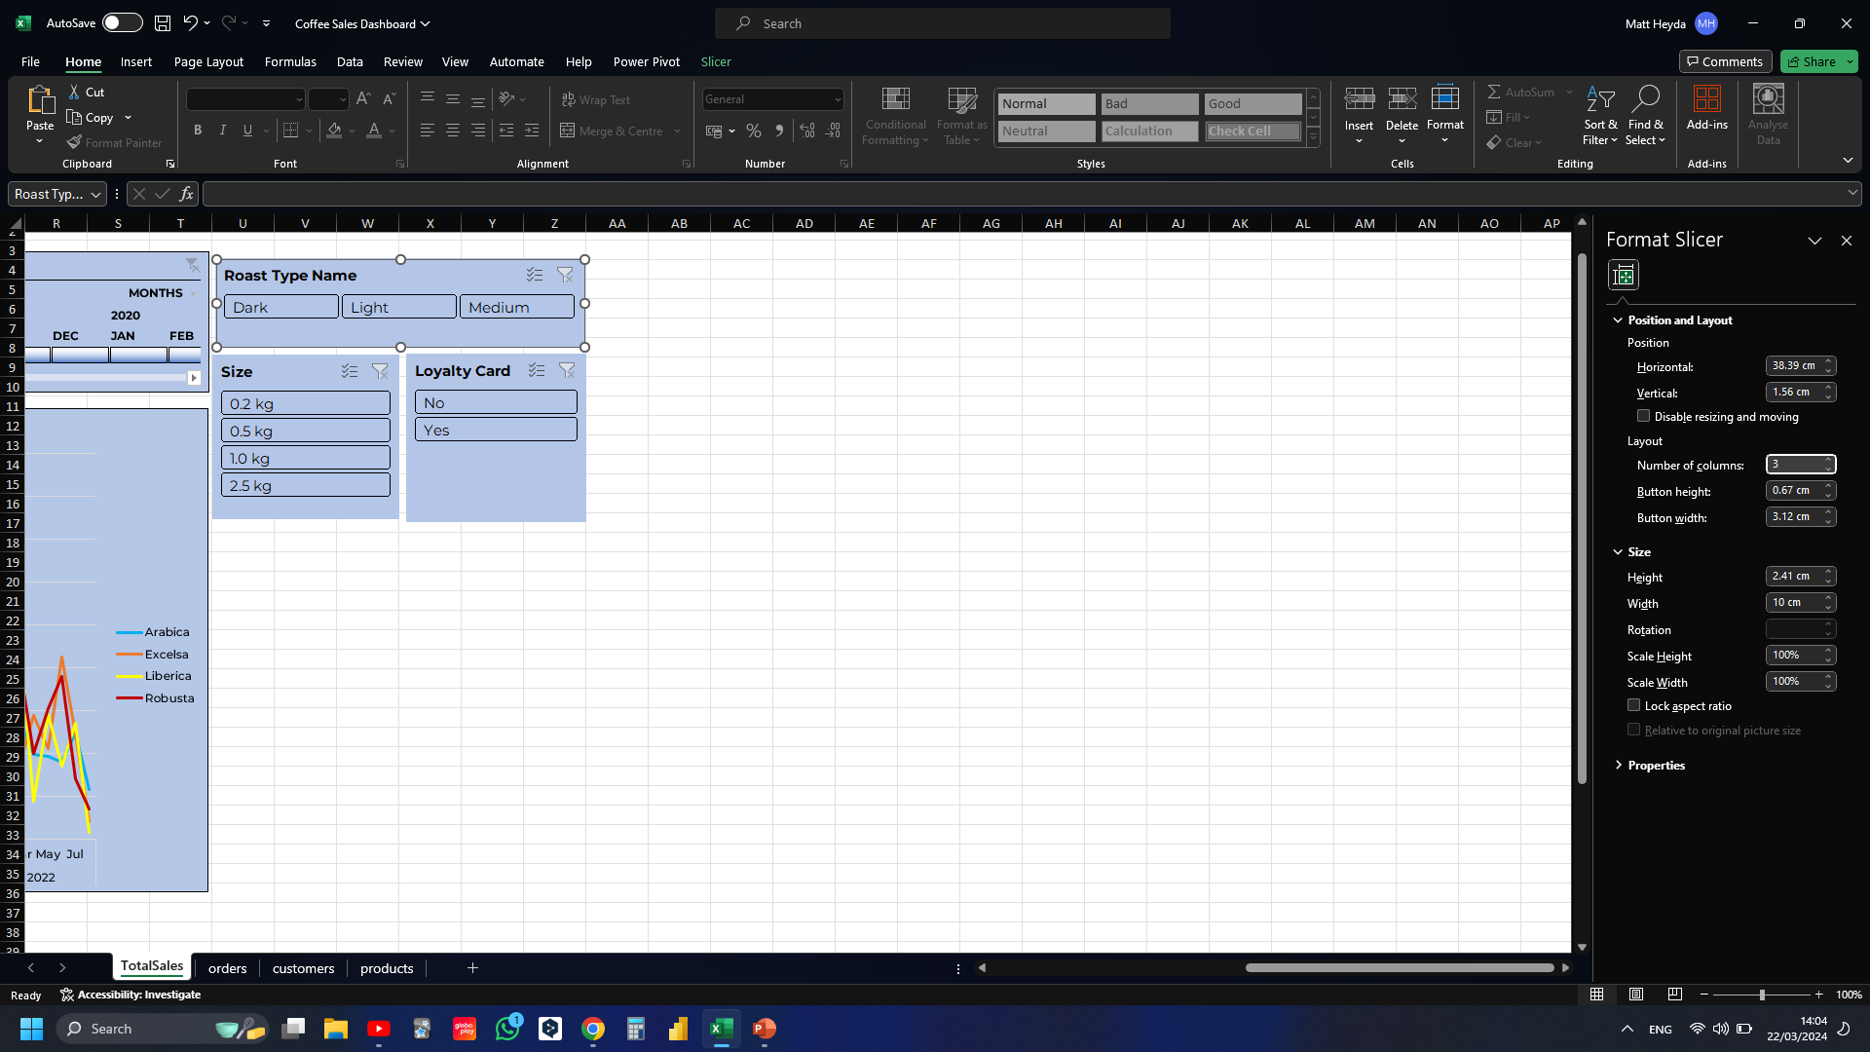
Notes:
Made roast type slicer, three columns instead of one to lay it horizontally

Slide 44
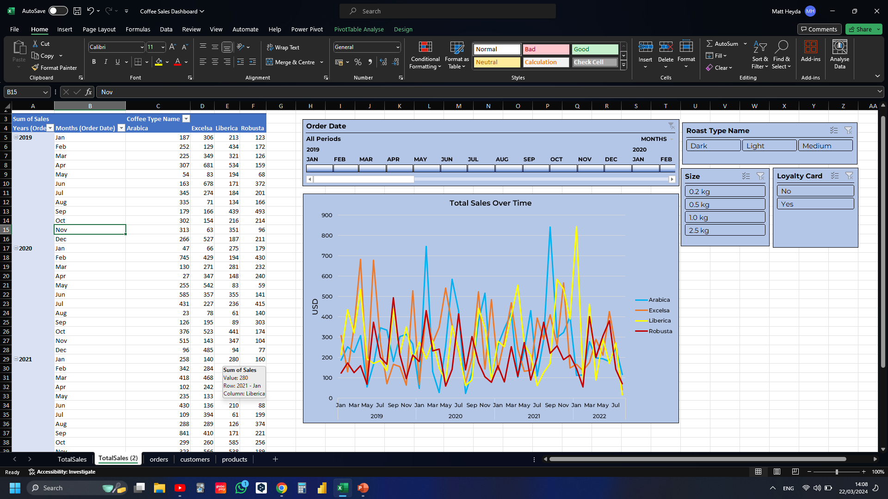
Notes:
Duplicated worksheet

Slide 45
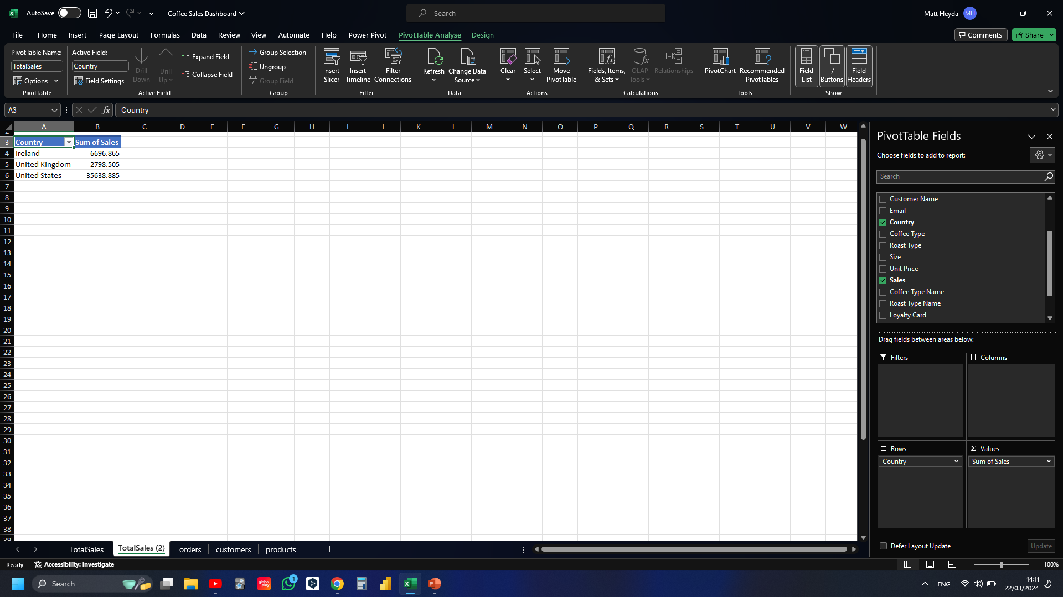
Notes:
Creating new pivot table with country and sales

Slide 46
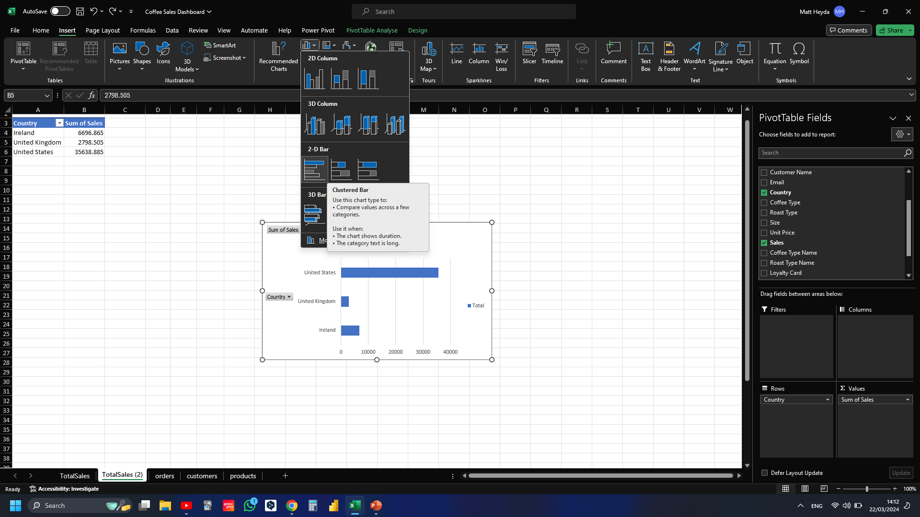
Notes:
Inserting bar chart

Slide 47
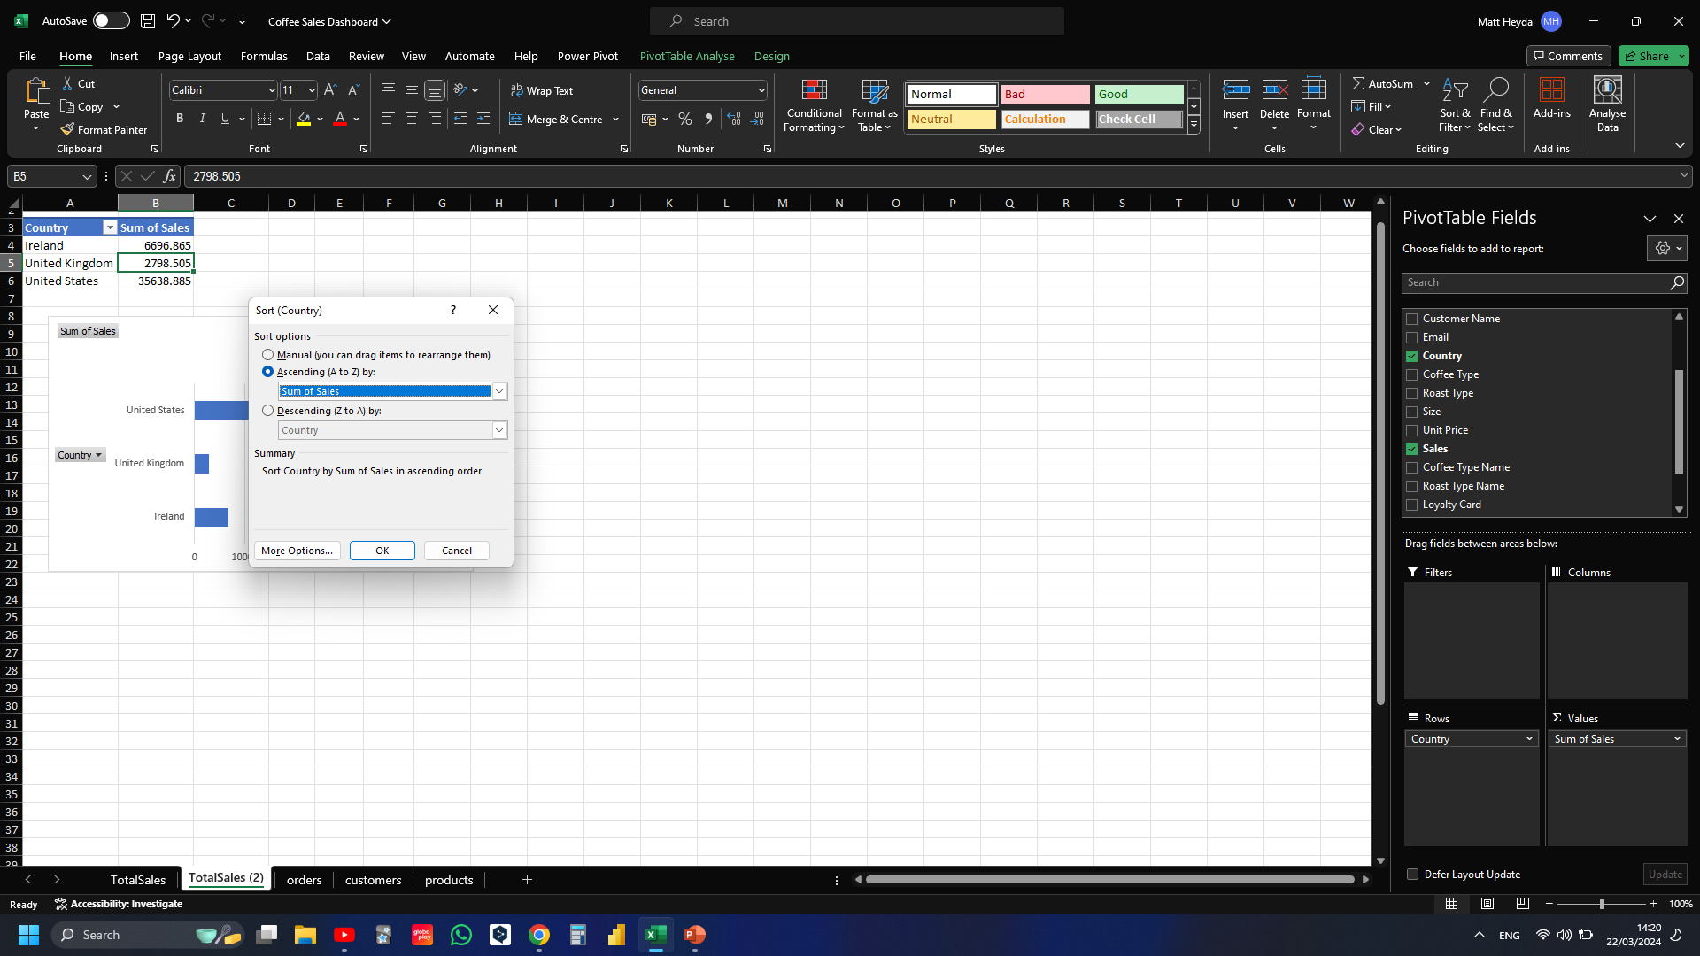
Notes:
Sorting countries so that theyre in ascending order

Slide 48
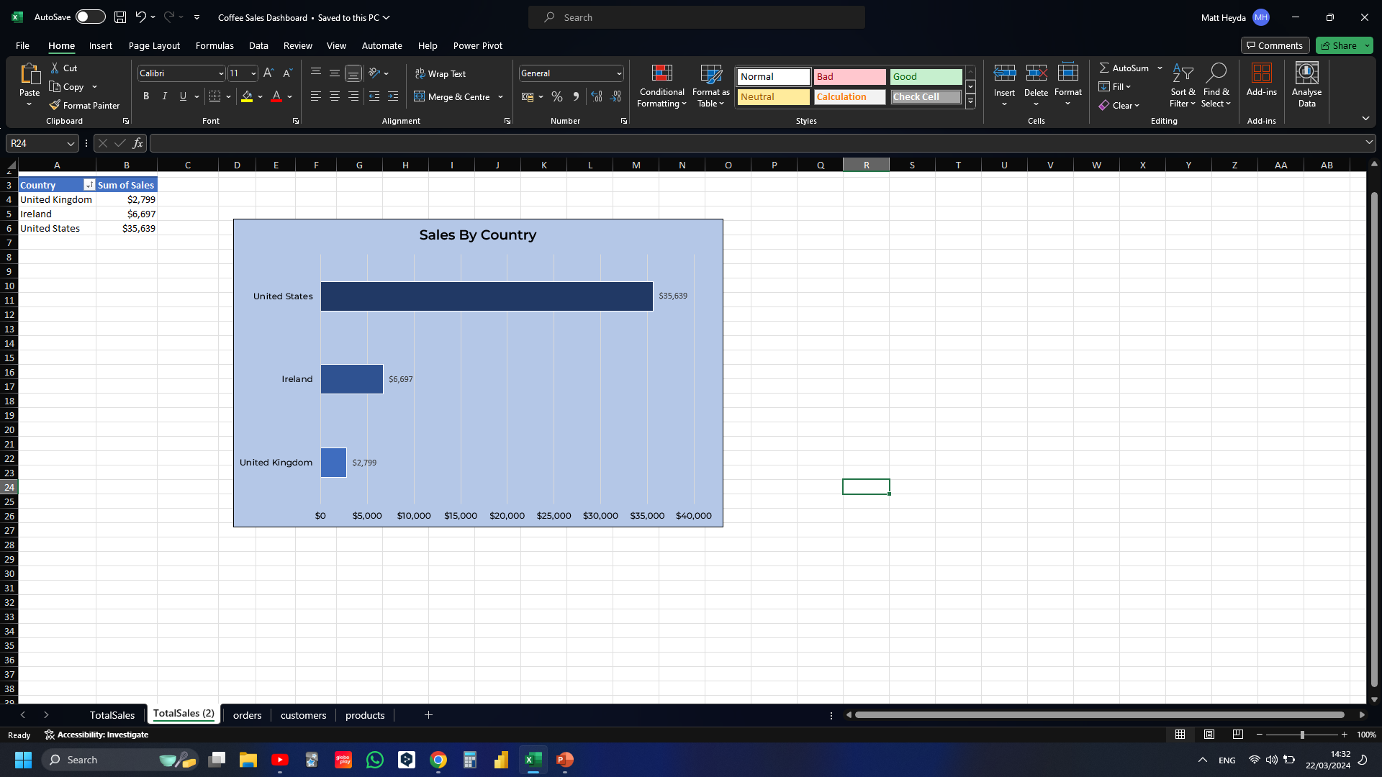
Notes:
Fomatted bar chart by adding title, adding bar lables, formatting the sales to appear as $, edited bar colours

Slide 49
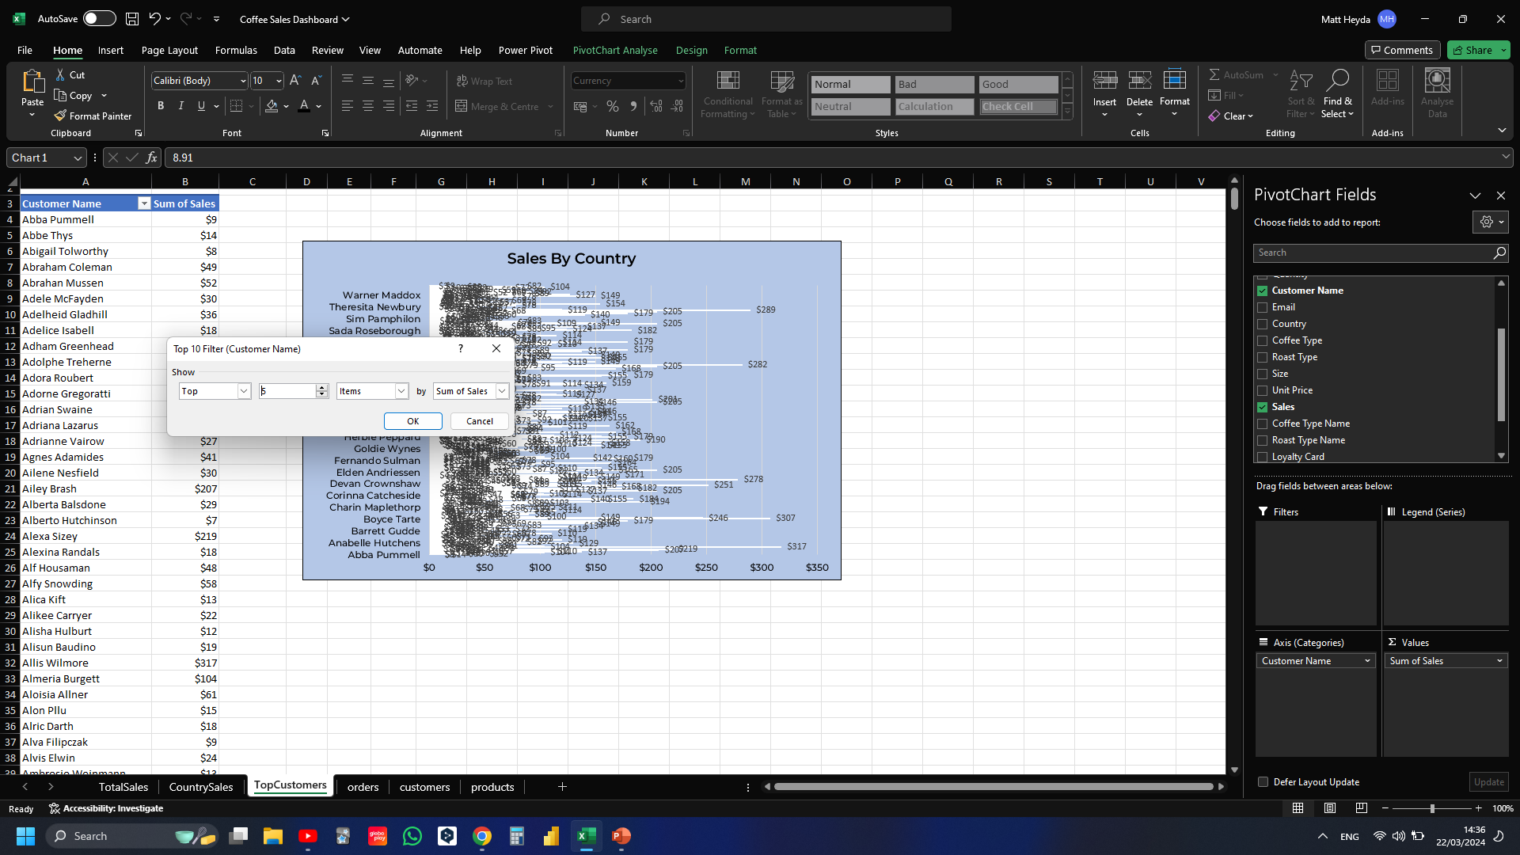
Notes:
Copied worksheet, created new bar chart with customer names, and filter the top 5

Slide 50


Notes:
Sorted by sales, added new title

Slide 51

Notes:
Created new worksheet called “dashboard”, added shape to the top using “alt” to snap to grid

Slide 52


Slide 53


